Slide 1



COM1025 Web & database systems
Lecture 2
Dr Mariam Cirovic
CSEE

Slide 2
Last Week
We considered the foundations of how the internet works
We created some simple JavaScript programs. We ran these programs in the Node.js environment.
However, we did not use any Node.js features. We just used JavaScript features.
Notes:
Develop students' understanding of the theory, design, and development of database systems and the key role database systems play in the real world
Equip students with the basic knowledge of frontend and backend web technologies that can be used to interface a database system
Develop students' analytical and problem-solving skills via modelling data of real-world problems
Perspective of the designer and developer of db systems

Slide 3
This Week
This week, we will be learning about Node.js features, and why we need them
Specifically, we will consider:
How to create simple web applications
Using templating languages
Using a package manager
Using a web framework
Notes:
We will be learning about the Node Package Manager (npm)

Slide 4
By the end of the week
You’ll be able to complete the following assessment tasks:
8. Application Structure [3 Marks]
10. A Minimum of 4 User-facing Routes Served [4 marks]
11. Construct EJS Views for the 4 Routes [3 marks]
Notes:
We will be learning about the Node Package Manager (npm)

Slide 5
The anatomy of a node project
Notes:
“Learn about the key technologies of Database systems and the World Wide Web (WWW)”. Why is the important?
Databases are the core component of most computer application.

Slide 6
A Typical Node.js Project
A node project is a folder that contains a package.json file.
The package.json file contains information about the project, including the packages it uses.
A package.lock file contains information about the packages that are installed in the project
There should be at least one JavaScript that will be the entry point for your application: e.g., index.js, app.js
| ── my-project
|── package.json
|── package-lock.json
|── node_modules
|── index.js

Slide 7

The Node Package Manager
The node package manager can be used to manage node projects (https://www.npmjs.com/)

Slide 8
The Node Package Manager(NPM)
npm is:
a package manager for JavaScript
if you have Node.js installed, you have npm installed!
the world's largest software registry
it provides a command-line interface (CLI) for managing packages and other tasks
it can be used to install, manage, and publish packages, manage dependencies, and run scripts

Slide 9

Getting Started with NPM
- Ensure your have NodeJS installed
- In the directory of your project run the terminal command: npm init
- You can keep pressing enter to accept the defaults.

Slide 10
You now have a package.json file
{
"name": "my_first_website",
"version": "1.0.0",
"main": "index.js",
"scripts": {
"test": "echo \"Error: no test specified\" && exit 1"
},
"author": "",
"license": "ISC",
"dependencies": {
},
"devDependencies": {},
"description": ""
}
The `package.json` file contains information about the project and is split into sections.
For this module, there are only three sections we care about:
The `devDependencies` field is a list of packages that the project depends on in development mode.
The `dependencies` field is a list of packages that the project depends on.

Slide 11
Getting Started with NPM
After running “npm init”; we can now install some packages
You can find packages by searching the https://www.npmjs.com/
Repository
Packages are open source and free
There are over 1.2million packages
Many are downloaded millions of times a week

Slide 12
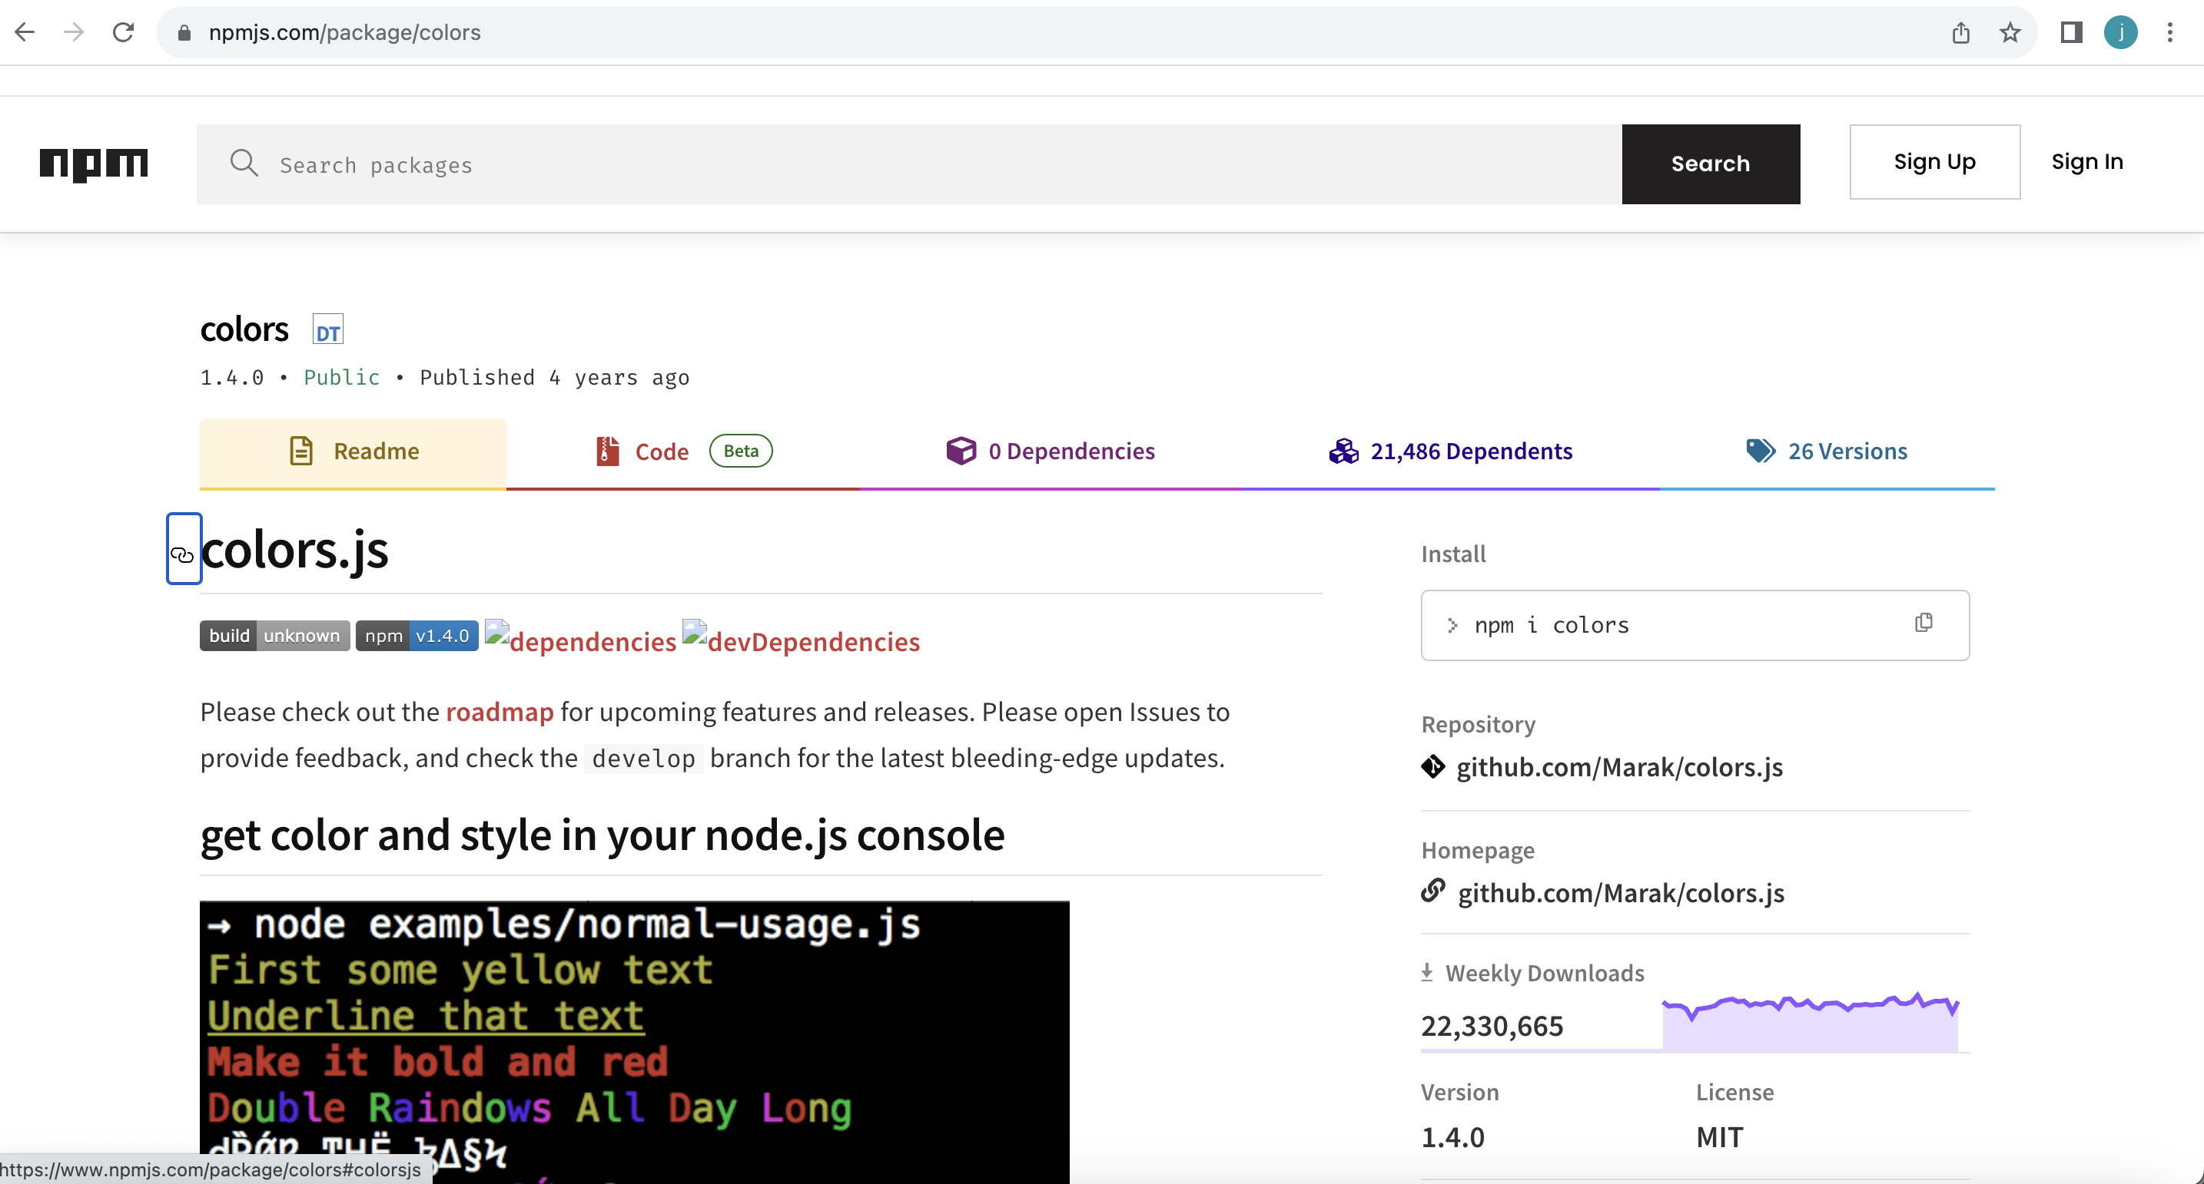
Let’s Install Colors (i)
This package lets us print different colors to the console
Name of the package
The source code
Documentation
Downloads

Slide 13
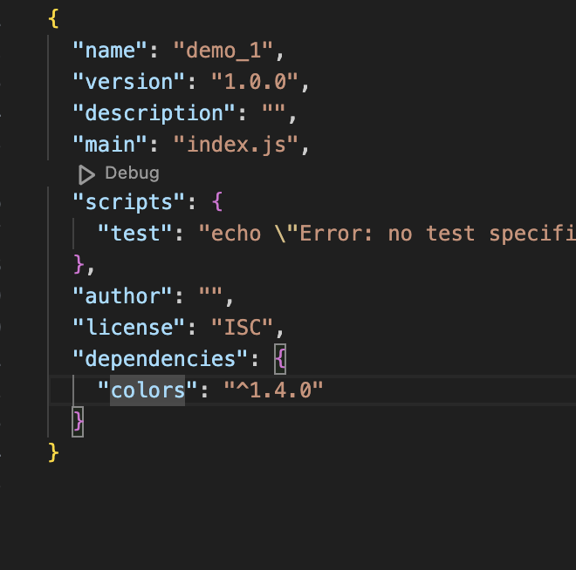
Let’s Install Colors.js (ii)
Dependencies are installed from command line.
Ensure your terminal window is pointed to the root of your project.
> npm install colors
Packages are stored in the "node_modules" folder
Dependencies listed in the ”package.json” file
Packages are stored in the "node_modules" folder

Slide 14

Using Packages
const colors = require('colors’);
console.log('Hello World!'.rainbow);

Slide 15
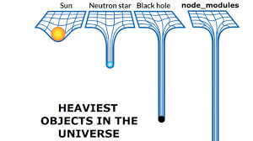
Some TIPS
Since packages have dependencies the ”node_modules” folder gets very heavy
Use .gitignore to exclude "node_modules" from version control
Delete the ”node_modules” folder before submitting your assessment
We can reinstall the dependancies by running “npm install”

Slide 16
DEMO
Notes:
“Learn about the key technologies of Database systems and the World Wide Web (WWW)”. Why is the important?
Databases are the core component of most computer application.

Slide 17
Web Development Frameworks
Notes:
“Learn about the key technologies of Database systems and the World Wide Web (WWW)”. Why is the important?
Databases are the core component of most computer application.

Slide 18
Web Development Frameworks
Notes:
“Learn about the key technologies of Database systems and the World Wide Web (WWW)”. Why is the important?
Databases are the core component of most computer application.

Slide 19
Web Development Frameworks
Notes:
“Learn about the key technologies of Database systems and the World Wide Web (WWW)”. Why is the important?
Databases are the core component of most computer application.

Slide 20
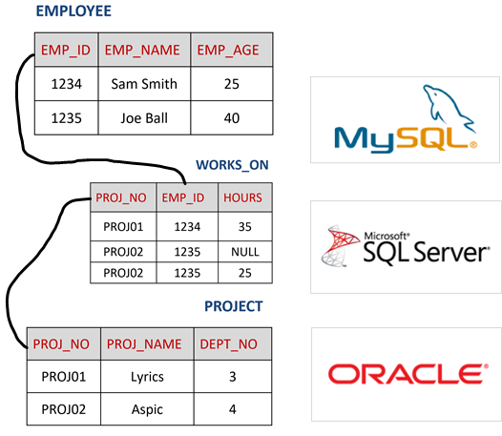
Learning Objectives
At the end of this section, you should be able to:
Describe the characteristics of the relational model
Explain how relations are linked together
Recall the different types of constraints and operations

Slide 21

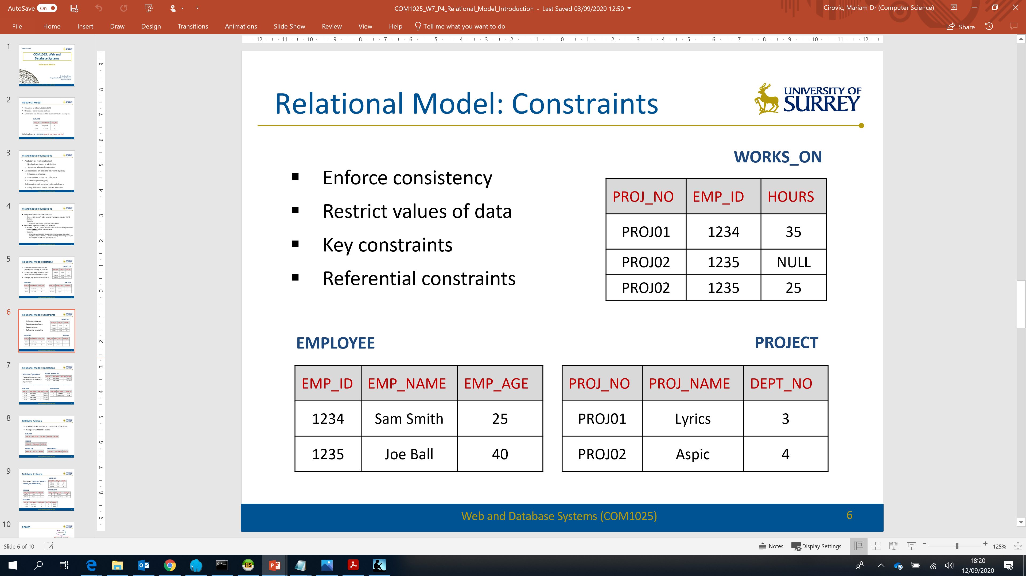




Relational Model
Conceived by Edgar F. Codd in 1970
Logical model
Collection of relations (tables), logical data structures to store data
Integrity rules to enforce data integrity (accurate & consistent data)
Operations to manipulate the data
Notes:
The relational model has been around for about half a century.
It is used by all major commercial database systems .
The relational model was conceived by a mathematician known as Edgar Cod, who worked for IBM in 1970 and his mathematical background, encouraged him to think about the data in terms of formal structures and the logical operations that could be formed on the structures.
0:56
And the relational model is also a logical model in the sense that the data is described in detail in a formal way,
but without regard to its physical implementation. If you recall the concept of data independence that we came across earlier,
1:16
it is a collection of relations which are actually tables which store the data
the integrity rules which enforce the data integrity when the data is entered into the database.
What we mean is that we can basically assure and maintain the accuracy and consistency of the data over its lifecycle.
And finally, it provides the operations to manipulate the data.

Slide 22


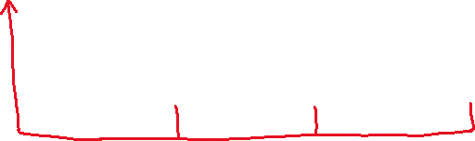


Relational Model
Database = set of named relations
A relation is a 2-dimensional data structure with attributes and tuples
NAME OF RELATION
ATTRIBUTE NAMES
EMPLOYEE
ATTRIBUTE VALUES
Emp_ID | Emp_Name | Emp_Age
1234 | Sam Smith | 25
1235 | Joe Ball | 40
TUPLES (RECORDS)
Degree: number of attributes (columns)
Cardinality: number of tuples (rows) at a given time
Notes:
Now, in the relational model, a database is basically a set of named relations,
where a relation is a two dimensional table with attributes and tuples.
2:02
Let's look at this example below here of a table called Employee.
Now, employee is the name of the relation, and this name has to be distinct in the database. This means that you cannot have 2 relation names that are the same.
And if you see these three columns, employee ID, employee name, employee age, these are the attribute names.
And they also have to be distinct in the relation.
Each intersection of the column and row is where a single data item is basically stored and these are known as attribute values.
Each row in this table is known as a tuple.
2:51
An important thing to remember here is that each row, tuple, record represents a single occurrence of an entity.
For example, the first row here is about an employee called Sam Smith.
And all the data there is basically about that particular employee and the same about the second tuple.
All the data in that tuple is about Joe book,
AND NO TWO ROWS CAN BE IDENTICAL.
the degree of a relation is the number of attributes, columns in that relationship.
For example, here that would be three.
And a cardinality of the relation is the number of tuples at a given time, which in our example is two.
Why “at a given time”? – Tuples can change over time!
the cardinality keeps changing because we will be adding more data - adding more rows to the table or deleting rows from the table.

Slide 23
Mathematical Foundations
Relational theory is based on predicate logic and set theory
A relation schema & a relation are mathematical sets
No duplicate attributes or tuples
Attributes and tuples are inherently unordered
EMPLOYEE
Emp_ID | Emp_Name | Emp_Age
1234 | Sam Smith | 25
1235 | Joe Ball | 40
Emp_Age
25
40
1234 | Sam Smith | 25
Notes:
The mathematical foundations and the intricacies of relational theory can be very complex and they're beyond the scope of this module.
The most important thing for you to know is that a relation is a mathematical set.
And the properties of that is that there can be no duplicate attributes or tuples and both are inherently unordered.
For example, we could not have another column.
With the same attribute name in the same table, so this would not be possible and similarly,
we cannot have a duplicate row or tuple in the table that would not be possible.
4:51
And what we mean by attributes that are inherently unordered.
That means that at the moment, if you see the order of the attribute names is employee ID, employee name,
employee age, they could easily be employee age, employee name, employee ID etc
That is completely irrelevant. And similarly, the order of the rows is not relevant.
5:15

Slide 24
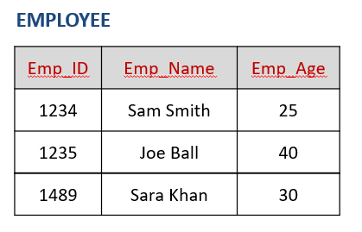
Mathematical Foundations
Relation Schema is a set of unordered attribute names
EMPLOYEE (Emp_ID, Emp_Name, Emp_Age)
Relation is a set of unordered tuples:
Employee ( (1234, Sam Smith, 25),
(1235, Joe Ball, 40),
(1489, Sara Khan, 30) )
A set of integrity rules (constraints)
A set of operations (to define data manipulation)
Notes:
The mathematical foundations and the intricacies of relational theory can be very complex and they're beyond the scope of this module.
The most important thing for you to know is that a relation is a mathematical set.
And the properties of that is that there can be no duplicate attributes or tuples and both are inherently unordered.
For example, we could not have another column.
With the same attribute name in the same table, so this would not be possible and similarly,
we cannot have a duplicate row or tuple in the table that would not be possible.
4:51
And what we mean by attributes that are inherently unordered.
That means that at the moment, if you see the order of the attribute names is employee ID, employee name,
employee age, they could easily be employee age, employee name, employee ID etc
That is completely irrelevant. And similarly, the order of the rows is not relevant.
5:15
It could be in any order. And relations schema can be represented like this, so you have the employee that's the name of the relation, and then you have the basically the attribute list within brackets.

Slide 25
Mathematical Foundations
Attribute Domain:
set of all permissible values for a column
E.g., ID:{x|x≥1000 & x≤1999}, Name: string, Age:{x|18 ≤ x ≤ 70}
NULL: special value for ‘unknown’ or ‘undefined’
Given a number of sets A₁, A₂, …, A_{n} R is a relation on these n sets such that it is a set of tuples, where each tuple has its first element from A₁ and the last from A_{n} E.g., for Employee:
ID {1234, 1589, 1489}
Name {Sam Smith, Sara Khan, Joe Ball}
Age {25, 30, 40}
Notes:
Here, we're going to just quickly look at how we can represent A RELATION as a set now we can say relation
is a set we are is the name of the relation and each of I is the I attribute in the relation.
5:49
And this is an example that we saw earlier of a religion called employee and its list of attributes names.
5:59
The very important thing here is the attribute Dumain. The attribute domain is the set of all permissible values for an attribute to column.
6:05
And for example, this is how you would represent that.
6:16
So each attribute A is basically has a domain deed, which is the name of the set of all the permissible values for that attribute.
6:20
For example, let's say for this example of a staff employee, the employee I.D. could be a value within a thousand then let's say 1999,
6:35
the name of the staff could be represented as a string and could be any basically characters within the string set.
6:49
And the roll could also be a string.
7:01
And the telephone number, let's say, has been specified from starting with 014 three and then the code 55 from zero zero zero zero,
7:03
all the way to nine nine nine nine. And last important thing for you to know is that NUL is a special value for an unknown or undefined domain.
7:14
Now, since relations are Sade's, then there are certain operations,
7:29
set operations that can be basically performed on these relations and there's a whole mathematical theory behind it,
7:36
which is known as relational algebra. We won't go into that.

Slide 26




Relational Model: Keys
Relations: relate to each other through the sharing of a column
Primary key (PK): an attribute(s) that uniquely identifies a tuple
Foreign key: attribute matches PK
WORKS_ON
PROJ_NO | EMP_ID | HOURS
PROJ01 | 1234 | 35
PROJ02 | 1235 | NULL
PROJ02 | 1235 | 25
EMPLOYEE
PROJECT
EMP_ID | EMP_NAME | EMP_AGE
1234 | Sam Smith | 25
1235 | Joe Ball | 40
PROJ_NO | PROJ_NAME | DEPT_NO
PROJ01 | Lyrics | 3
PROJ02 | Aspic | 4
Notes:
Now, relations relate to each other through the sharing of a column,
and the primary key is basically is an attribute or a set of attributes that uniquely identifies a tuple, unchanging & not null – has to be given a value
And a foreign key is basically an attribute, a set of attributes in one table, which matches the primary key of another table.
8:50
And basically these matching keys are what are used to relate the tables to each other.
For example, employee ID is the primary key of the employee table, and you can see it in the works on table.
So basically now you can relate these two tables together. Similarly,
project number is the primary key of the project table and you can see it in
the works on table so you can relate the project and works on tables together.
9:26
And what we can now glean from here is basically we can find out which employee is working on what project, a project and for how many hours.
So this is basically a very simple way of linking these tables together.

Slide 27








Integrity Rules/Constraints
WORKS_ON
Enforce consistency
Restrict values of data
Key constraints
Referential constraints
PROJ_NO | EMP_ID | HOURS
PROJ01 | 1234 | 35
PROJ02 | 1235 | NULL
PROJ02 | 1235 | 25
EMPLOYEE
PROJECT
EMP_ID | EMP_NAME | EMP_AGE
1234 | Sam Smith | 25
1235 | Joe Ball | 40
PROJ_NO | PROJ_NAME | DEPT_NO
PROJ01 | Lyrics | 3
PROJ02 | Aspic | 4
Notes:
Now, the relational model also provides basically constraints on the relations and these concrete constraints enforce consistency.
9:51
For example, let's look at the project table. It has a department number.
And what we can do is we can put a constraint on that, such that the department number cannot be null.
It's always of value has to be provided because a project cannot exist without a department.
And secondly, we can basically give a list of valid department numbers and the department number has to be provided from that list.
Will we ensure that you cannot have a wrong department number there?
10:32
It also can restrict the values of data, basically.
Each column has a specific range of values
All values in a column must have the same data type
For example, if its employee hours, we can say that the maximum hours worked have to be,
let's say, 40 and actually a null can be provided when a project hasn't started yet.
So we're not exactly sure how many hours that employee will be working on it.
Now, the relational model also provides key constraints, basically,
which means that each key is basically going to be unique and it has to be not null.
And finally, they're also the referential constraints, which are basically that if there is a table, let's say the works_on table, that has got.
The primary keys are for the employee and project table, then basically we make sure that if we delete an employee from the employee table,
then basically the row in the works on table has got to be deleted as well.
11:52
Otherwise they'll be inconsistency in the database.

Slide 28
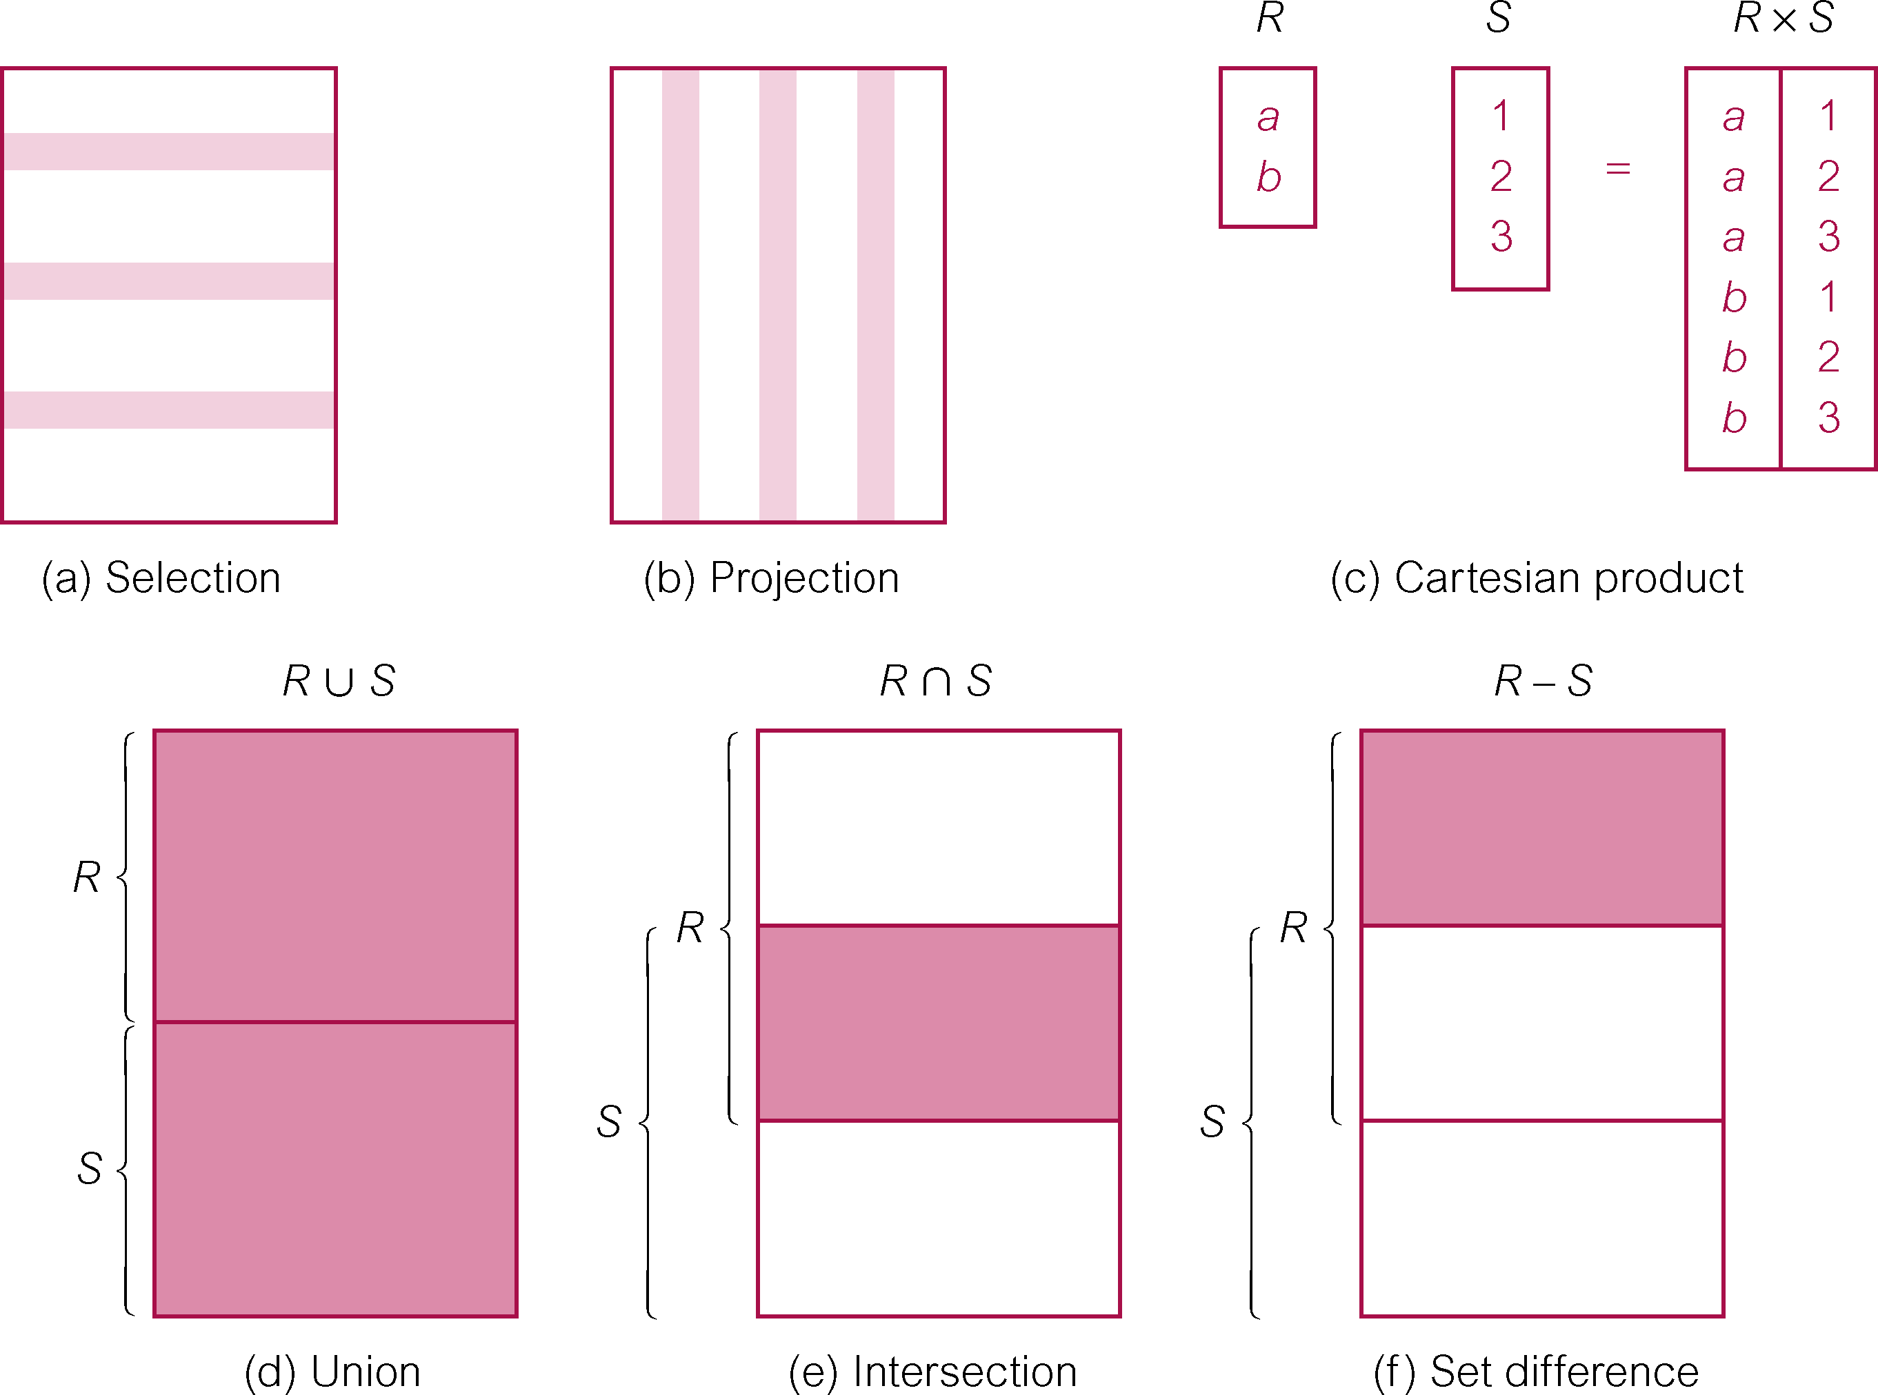
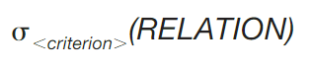
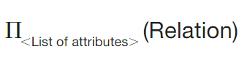
Mathematical Foundations: Operations
Set operations on relations (relational algebra)
Selection
Projection
Notes:
Now, since relations are sets, then there are certain operations,
set operations that can be basically performed on these relations and there's a whole mathematical theory behind it,
which is known as relational algebra. We won't go into that.
7:44
Just important for you to know is that there are these set operations such as selection projection,
7:48
union intersection, set difference, Cartesian product.
7:55
We will be looking at all of these as we go on in our lecture material.
Select (restrict)
Unary operator that yields a horizontal subset of a table
Project
Unary operator that yields a vertical subset of a table
Union
Combines all rows from two tables, excluding duplicate rows
Union-compatible: tables share the same number of columns, and their corresponding columns share compatible domains
Intersect
Yields only the rows that appear in both tables
Tables must be union-compatible to yield valid results

Slide 29
Mathematical Foundations: Operations
Builds on the mathematical notion of closure
Every operation always returns a relation
Notes:
And a very, very important thing for you to know also is that this builds on the mathematical notion of closure,
8:06
which means basically that every single operation that is performed on relation or a number of relations together will always return a relation.
It's a very important concept for you to remember.

Slide 30






Relational Model: Operations
RESEARCH_EMPLOYEE
“Select all the employees that work in the Research department”
EMP_ID | EMP_NAME | DEPT_NO | SALARY
1234 | Sam Smith | 3 | 30000
1230 | Mark Malon | 3 | 800000
EMPLOYEE
DEPARTMENT
EMP_ID | EMP_NAME | DEPT_NO | SALARY
1234 | Sam Smith | 3 | 30000
1235 | Joe Ball | 4 | 50000
1230 | Mark Malon | 3 | 800000
1239 | Chris Clark | 4 | 100000
DEPT_NO | DEP_NAME | MANG_ID
3 | Research | 1230
4 | Headquarters | 1239
Notes:
Now, if you recall, the relational model also provides a number of set operations that can be performed on the relations.
Now, let's take an example of, let's say, the select operation.
And this is what we want to do. We want to select all the employees that work in the research department.
So we have these two tables below employee and department.
Now, let's look at the department table and we see that we do have a department named called Research,
and the department number for research is three. And now we linked that to the employee table.
And we actually find the two tuples with the department number three, and we can then select the two employee employees that work in that department.
And what we come up with is a new relation, covid research employee.
The very important thing for you to remember again is this notion of closure
that any operation this performed in the relation or set of relations will basically result in a new relation.

Slide 31
Database Schema
A Relational database is a collection of relations
COMPANY Database Schema
EMPLOYEE
EMP_ID | EMP_NAME | EMP_AGE | DEPT_NO | SALARY
PROJECT
PROJ_NO | PROJ_NAME | DEPT_NO
WORKS_ON
DEPARTMENT
PROJ_NO | EMP_ID | HOURS
DEPT_NO | DEPT_NAME | MGR_ID
Notes:
A relational database is basically a collection of relations,
13:14
so some of these relations we will see before we can say that's part of the company database
13:19
schema and then the basically the relations themselves will have the relation schema.
13:26
So basically the database schema is made up of all the relations schemas.
13:34

Slide 32
Database Instance
WORKS_ON
Company (EMPLOYEE, PROJECT, WORKS_ON, DEPARTMENT)
PROJ_NO | EMP_ID | HOURS
PROJ01 | 1234 | 35
PROJ02 | 1235 | NULL
PROJ02 | 1235 | 25
PROJECT
DEPARTMENT
PROJ_NO | PROJ_NAME | DEPT_NO
PROJ01 | Lyrics | 3
PROJ02 | Aspic | 4
DEPT_NO | DEP_NAME | MANG_ID
3 | Research | 1230
4 | Headquarters | 1239
EMPLOYEE
EMP_ID | EMP_NAME | EMP_AGE | DEPT_NO | SALARY
1234 | Sam Smith | 25 | 3 | 30000
1235 | Joe Ball | 40 | 4 | 50000
Notes:
A database instance is just basically at a given moment in time, all the data that is present in the database at that particular moment.

Slide 33
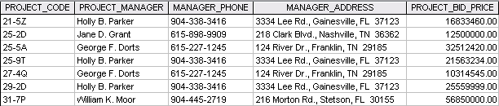
Example 1
7
How many records does the file contain (cardinality)?
5
How many fields does the file contain (degree)?
Notes:
Database models have evolved over time based on type of data and application needs
E-commerce and social networking applications generate a high volume of unstructured data
Choice of database depends on the type of data and the information needs of an organisation
Relational databases are still dominant in the market
Db has data that
Represents some aspects of the real world
Has an intended group of users and application
Is logically coherent with inherent meaning and relationships
that exists over a period of time

Slide 34
Example 2
What problem would you encounter if you wanted a listing by city?
What data redundancies do you detect?
If you want a listing by Last Name, Area code, City, State, Zip Code, how would you alter the file structure?
Notes:
The city names are contained within the MANAGER_ADDRESS attribute and decomposing this character (string) field at the application level is cumbersome at best. (Queries become much more difficult to write and take longer to execute when internal string searches must be conducted.) If the ability to produce city listings is important, it is best to store the city name as a separate attribute.
Note that the manager named Holly B. Parker occurs three times, indicating that she manages three projects coded 21-5Z, 25-9T, and 29-2D, respectively. (The occurrences indicate that there is a 1:M relationship between PROJECT and MANAGER: each project is managed by only one manager but, apparently, a manager may manage more than one project.) Ms. Parker's phone number and address also occur three times. If Ms. Parker moves and/or changes her phone number, these changes must be made more than once and they must all be made correctly... without missing a single occurrence. If any occurrence is missed during the change, the data are "different" for the same person. After some time, it may become difficult to determine what the correct data are. In addition, multiple occurrences invite misspellings and digit transpositions, thus producing the same anomalies. The same problems exist for the multiple occurrences of George F. Dorts.
The more we divide the address into its component parts, the greater its information capabilities. For example, by dividing MANAGER_ADDRESS into its component parts (MGR_STREET, MGR_CITY, MGR_STATE, and MGR_ZIP), we gain the ability to easily select records on the basis of zip codes, city names, and states. Similarly, by subdividing the MANAGER name into its components MGR_LASTNAME, MGR_FIRSTNAME, and MGR_INITIAL, we gain the ability to produce more efficient searches and listings. For example, creating a phone directory is easy when you can sort by last name, first name, and initial. Finally, separating the area code and the phone number will yield the ability to efficiently group data by area codes. Thus MGR_PHONE might be decomposed into MGR_AREA_CODE and MGR_PHONE. The more you decompose the data into their component parts, the greater the search flexibility. Data that are decomposed into their most basic components are said to be atomic.

Slide 35
Introduction to Entity-Relationship (ER) Modelling

Slide 36
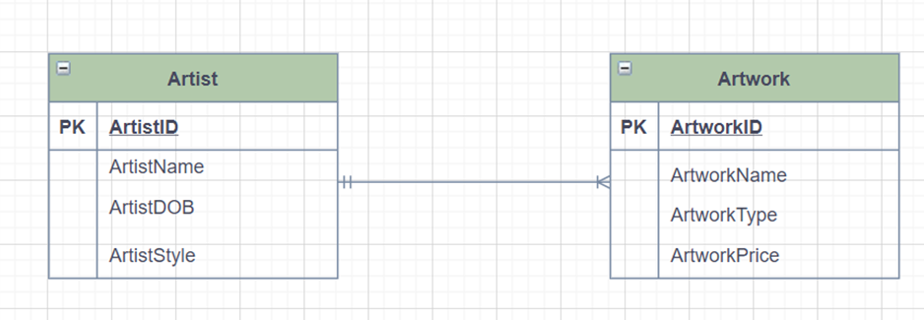
Learning Objectives
At the end of this section, you should be able to:
Describe the importance and use of the ER Model
Recall the different notations for the ER model
Recall the main element types of the ER model

Slide 37

What is an ER Model?
A relational model cannot be used as a design tool
Easier to examine structures visually/graphically
The ER model (conceptual) became widely popular as a complement to the Relational Model (logical)
Foundation for database design!
MINIWORLD
REQUIREMENTS COLLECTION AND ANALYSIS
CONCEPTUAL DESIGN
LOGICAL DESIGN
PHYSICAL DESIGN
INTERNAL SCHEMA
Notes:
Now, as you will understand, a relational model cannot be easily used as a design tool for the end users to basically be able
to understand these database and table schemas and all that is going to be quite difficult.
0:42
It's much easier to examine structures if they're represented either visually or graphically.
Now, the entity relationship model, which sits at the conceptual a level of database design,
became widely popular as a complement to the relational model in the 70s,
And it is the foundation for database design.

Slide 38
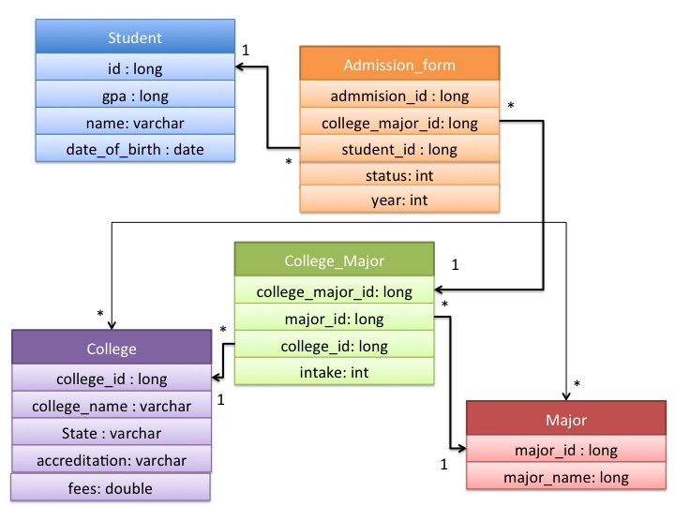
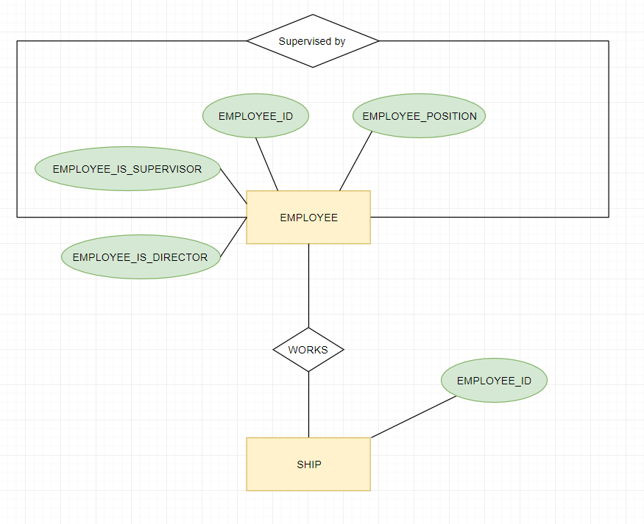
What is an ER Model?
Provides a detailed representation of the data of interest to an organisation
Understandable to both users and experts
Used to model any data in any application
Independent of any technology
It has become an industry standard for conceptual design of database systems
Notes:
Now the entity relationship model provides a detailed representation of the date of interest
to an organisation in such a way that it is understandable to both the users and the experts.
1:26
And that is basically what is critical for the database design,
because the main purpose is to get the complete requirements of the users modelled correctly.
1:39
So the easier it is to communicate and understand the concept for both the users and the experts,
then the higher the chance to get an accurate data model.
1:55
Now they want to do it, can be used because it is a conceptual model to model any data in any application.
2:00
It is not restricted to a particular database management system or an operating system or anything.
It's completely independent of any technology. And because of that, it has become an industry standard for conceptual design of the databases.

Slide 39
ER Model Element Types
Entity types in the business environment
Strong and weak entities
Identifying attribute(s)
Relationship types (associations) among the entities
Degree: binary most common (unary, ternary…)
Participation: optional or mandatory
Connectivity and Cardinality: zero, one or many
Attributes of the entities and their relationships
Single/multi-valued
Domain: set of allowable values
Simple/composite/derived
Notes:
The Entity-Relationship Model is expressed in terms of three principal element types:
Also comes with ER diagram -
Now, let's have a look at the different element types that the entity relationship model provides,
the first and the most important are the entity types in the business environment. Group of objects with same properties, identified by enterprise as having an independent existence.
The entity types can be strong or weak where the weak entities depend on the strong ones.
2:36
Each entity type has got some identifying attributes where these values would be unique for each instance of that entity type.
2:43
Now they are also associations amongst entities which are known as relationship types,
2:54
and they're there can be a different degree to do Reiki, for example.
3:00
The most common are binary relationships, which are relationships between two entities.
3:05
But you can also have a relationship between the same entity or between three or more entities.
3:11
And we study these in more detail further on in the module.
Now, the other thing we need to consider in relationships is the participation of the entities which can be either optional or mandatory.
3:23
So an entity may not enter the instance, actually may not participate in the relationship or it has to participate in the relationship.
3:31
And finally, what we need to look at is the connectivity with the cardinality, which sees whether it should be zero,
3:40
one or many occurrences of the entity that can participate in the relationship,
3:48
the entities and relationships that have attributes which are basically descriptive of the entities and the relationships.
3:55
And these can be a single that means can have just one value or they can be multi valued,
4:03
they can be a simple or they can be composed where they constitute other attributes.
4:11
They can boast of other attributes or they can be derived,
4:19
which means that you can use other attributes or some other computation to get to the value of that particular derived attribute.
4:23
And the domain of the attributes is the set of allowable values for the attributes.
Entity type
Group of objects with same properties, identified by enterprise as having an independent existence.
Entity occurrence
Uniquely identifiable object of an entity type.
Relationship type
Set of meaningful associations among entity types.
Relationship occurrence
Uniquely identifiable association, which includes one occurrence from each participating entity type.
Degree of a Relationship
Number of participating entities in relationship.
Relationship of degree :
two is binary
three is ternary
four is quaternary.

Slide 40
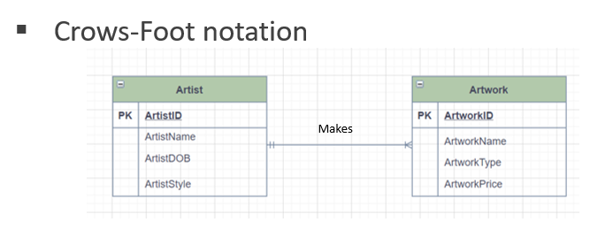
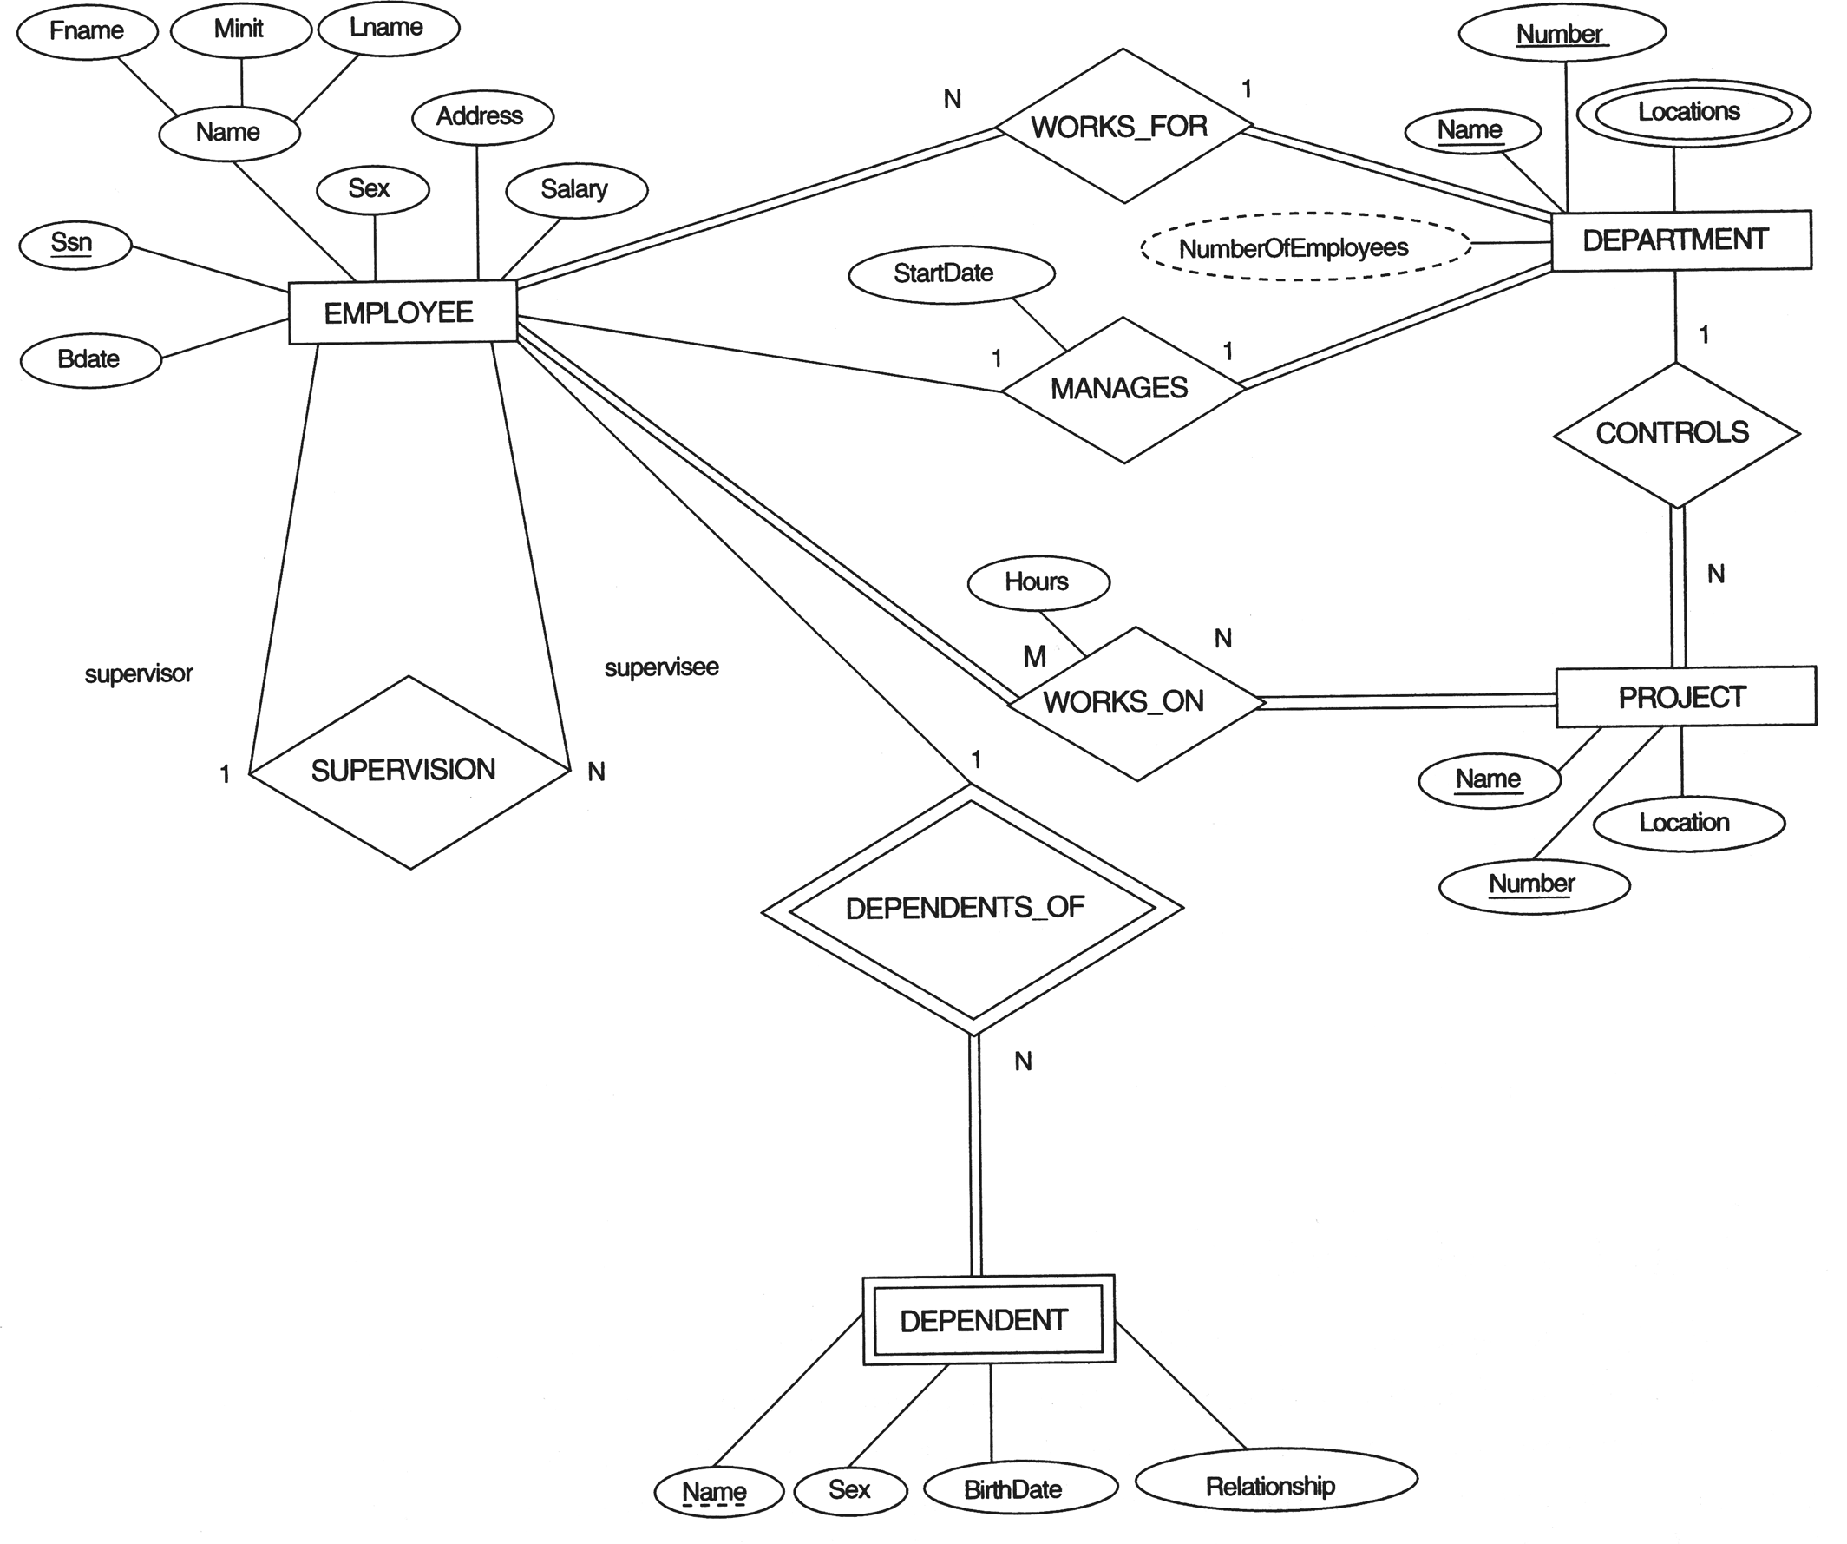
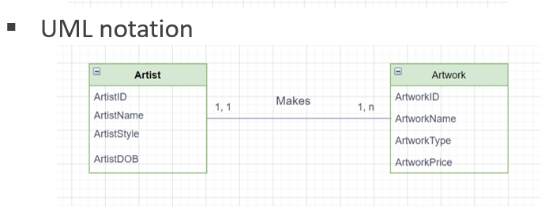

ER Diagram (ERD) Notations
Chen notation
Notes:
Now, an entertainment relationship model can be represented in an entity relationship diagram, which is basically graphically represents the model.
4:42
And here we see an example of the notation, not chain was actually the person who invented the entity relationship model.
4:53
He worked for IBM as well, same as Cod.
And he invented this to address the issues with the relational model to be used as a design tool in about 1976.
5:05
Now, if you see here, we can have a very quick look to we will study this in detail later.
So, for example, the rectangles are the entity types of employee.
5:22
And if you see the rectangle with two lines, the dependent is what is known as a weak entity time because it depends on the employee.
5:27
If you take the employee out of the database, that particular instance of an employee,
5:37
you have to also delete information about the dependent because there's no need to keep that.
5:41
And if you see the supervision is a relationship that's presented as a diamond.
5:48
And this is a unique relationship because it's between the one entity of employee and an employee who works for a department.
5:53
And that's a one to many relationship between department and employee,
6:06
so many employees could work for one department if Sea Department has a multi valued to build their locations and hold all the keys,
6:11
all the sorry attributes that you see are underlined are basically the identifying attributes for those entity types.
An E/R diagram is a graph representing entity sets, attributes, and relation-
ships.
Elements of each of these kinds are represented by nodes of the graph, and we use a special shape of node to indicate the kind.
To represent relationships appropriate for first-class objects we use Chen's notation for entity–relationship modeling:
Entity sets are represented by rectangles.
Attributes are represented by ovals.
Relationships are represented by diamonds.
Edges connect an entity set to its attributes and also connect a relationship to its entity sets.

Slide 41
Structured Query Language (SQL)
Notes:
“Learn about the key technologies of Database systems and the World Wide Web (WWW)”. Why is the important?
Databases are the core component of most computer application.

Slide 42

Learning Objectives
At the end of this section, you should be able to:
Describe the importance and use of the Structured Query Language (SQL)
Recall the DDL and DML parts of SQL
Recall how SQL is used in applications

Slide 43
What is SQL?
SQL is a declarative language designed for relational databases:- What is to be done not How to do it
Relational algebra/calculus underlying foundation
Supported by most commercial relational DBMSs
It is a standard (ANSI, ISO) SQL-86 ……. SQL-2016
SQL = DDL + DML
Notes:
Now, Escadrille is a declarative language which has been specially designed for relational databases.
0:32
Now a declarative language expresses the logic of a computation, but not the control flow.
For example, you can specify what you want out of the database, but not how to get the data out.
0:45
It was originally developed in the mid 70s by IBM to support the relational model.
0:54
So it has got the foundation of the relational algebra and calculus.
Now, school is supported by most commercial, a relational database management systems, which are basically a billion dollar market,
1:10
and Eskil has been standardised by the American National Standards Institute and also by the International Standards Organisation in the mid 80s,
saying that, however, most of the database vendors do tend to have their own flavours of escarole and don't strictly follow the standards.
And many have developed their own extension’s.
Now school provides commands that allow users to define the database.
1:42
Tables and structures is known as the detat definition language abbreviated to a DDL.
And it also allows you to query and update the database, which is done through the data manipulation language, which is abbreviated to death metal.
To build a database and load it with data
declarative language – a paradigm that expresses the logic of a computation without describing its control flow.
just declares what to achieve, but not how to do it.
SQL became a standard of the American National Standards Institute (ANSI) in 1986, and of the International Organization for Standardization (ISO) in 1987.
Most implementations do not strictly follow the SQL standard(s).
⇒ SQL code may not be portable without modifications.
MySQL is not strictly ISO/IEC standard compliant.
Some functions/behaviors are missing/ignored/changed.
Some non-standard extensions are added.
This is the common practice of most DB vendors except a few (e.g. PostgreSQL) which strive to be standard compliant.
Not a complete language like Java, Visual Basic or C++ – SQL is sub-language of about 30 statements – Embedded in another language or tool for database access – SQL has several inconsistencies; NULLs are problematic – Portable across operating systems and somewhat among vendors – Declarative language, not procedural

Slide 44
What can SQL do?
DDL (Data Definition Language)
CREATE TABLE/DATABASE: create a new table / database
ALTER TABLE (*): modify a table
DROP TABLE/DATABASE: delete a table / database
...............
DML (Data Manipulation Language)
INSERT: insert new data into a database
UPDATE, DELETE: update or delete data from a database
SELECT: retrieve data from a database
Data Integrity
Enforces keys, constraints, referential integrity, transactions
………………………….
CRUD
Notes:
So what can you do? So let's look at some of the most important commands of Ezekial,
2:15
the data definition language DDL basic operations to convert a data model to a database
allows you to create in your database and then create the required tables within the new database,
specifying the structure of the table, the columns and the data types of the columns.
And it allows you to modify a table using the alter table of command.
2:41
Also, you can delete a table using the table command or you can go and delete the whole database using the drop database command.
2:47
Now, the data manipulation language lets you insert new data into a database, it allows you to update any data in the database.
For example, this phone number has changed or the address has changed.
So that can be updated or even delete certain rows.
Let's say some customers have left, you can delete those arose from a table.
3:18
And finally, the all powerful select statement, which you'll be looking at in more detail later,
ALSO KNOWN AS QUERY LANGUAGE
allows you to retrieve data from a database using a variety of different conditions
3:30
so that you can get whatever useful information out from the database that you want.
Now, four of these main commands together are known as the crud, so they create, read, update and delete.
and it also goes ahead to specify other things, such as indexes, views, access, control and security, which we will not be looking at at this point.
QL often considered part of DML
Other commands: indexes, constraints, views, triggers, transactions, authorization
Access control, security,
Data sharing

Slide 45
DDL Component of SQL
Specify schemas of relations (with constraints)
CREATE TABLE table1_name
(
column_1 data_type_1 [constraint], column_2 data_type_2 [constraint], column_3 data_type_3 [constraint],
…
PRIMARY KEY (column_name(s)),
FOREIGN KEY (column_name(s)) REFERENCES
table2_name(column_name(s)),
UNIQUE (column_name(s))
);
Notes:
Now, let's look in more detail at the create table statement,
4:22
which allows you to specify schemas of relations together with their constraints and as part of the DDL component of Ask You Out Now,
create table statement allows you to specify the structures of the tables.
4:37
The first thing you need to specify is the table name, which, if you remember,
has to be unique in the relational schema and then you have to specify the column names where each column name also has to be unique in this schema.
4:50
So each column name will also have to have a data type specified and the constraint is optional.
For example, that could be not null. And then you can specify the primary key.
And this could be one column name.
5:19
Or if it's a composite primary key, then it could be a list of column names that make up the primary key of this table.
Now, the foreign key is going to be any list of column names which basically reference another table.
5:31
And the column name specified for that table, which basically are the primary key of that table, that is table to.
Now, the unique constraint allows you to specify any column names that you want to be unique within this table.
For example, let's say it's a table about departments and the department name can be declared to be unique.
5:59
If in that company or let's say the university, we don't want to have two departments having the same name.
So that can be specified as unique.

Slide 46
DML Component of SQL
Insert data into the tables
INSERT INTO table_name
(column_1, column_2,…, column_n)
VALUES (value_1, value_2,…,value_n);
Select data from the tables (Query!)
SELECT attribute_1, attribute_2,…,attribute_n
FROM table_1, table_2,…, table_m
WHERE <condition>;
Notes:
Now, the insert statement allows you to insert data into the table structure that you have already created,
so you use the insert clause here and you specify the table name, and then you have the list of column names in which you want to insert the data.
6:31
And then you basically have to specify each datA item, each value in the same order, for example,
value, one has to be for column one, value two for column two and value and for column F.
6:56
Now, the select statement is what we use to query the tables, and this is the most powerful aspect of SQL
So the select clause allows you to specify any number of attributes.
Which can be selected from any number of tables.
7:22
According to where certain conditions that you specify will hold,
which allow you to basically extract a wide variety of information that you may want from the database.

Slide 47
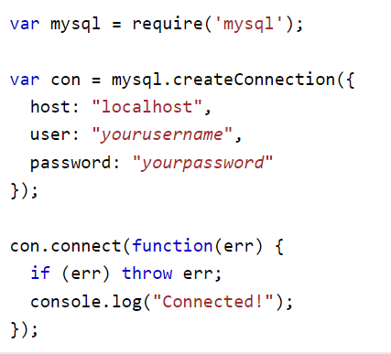


Using SQL
Can be used via GUI and command prompt but mostly embedded in a programme
private static final String USERNAME = "root";
private static final String PASSWORD = "password";
private static final String CONN_STRING = "jdbc:mysql://local:3306/test";
public static void main(String[] args) {
Connection conn = null;
try {
conn = DriverManager.getConnection(CONN_STRING,USERNAME,PASSWORD);
System.out.println("Connected");
}catch (SQLException e){
System.err.println(e); }
}
Notes:
Now we will be using Square mainly through the command prompt,
7:47
but can also be used via a gooey my school provides a MySQL workbench that gives you a gooey you can work through.
7:54
And even the leprechaun that we are using in the labs just provide a web interface.
But in reality, the most common way to use SQL would be embedded in a programme.
And we will see that as well. We will use it in our code.
8:16
And also in your second semester, you will use it through a Java programme.
Now you can connect to a database to be or Java using a connexion string, not a connexion string, for example, in P.
8:31
P basically consists of the server name, which is usually the local host, and then a username and password for the database.
Now to the GBC and Java usually specify the basically the port here you can see it says three three 06 and then the name of the database,
8:52
for example, my DB. And then you get a connexion by using this connexion string you created as well as the username and password.

Slide 48
Database Design
Notes:
“Learn about the key technologies of Database systems and the World Wide Web (WWW)”. Why is the important?
Databases are the core component of most computer application.

Slide 49

Learning Objectives
At the end of this section, you should be able to:
MINIWORLD
REQUIREMENTS COLLECTION AND ANALYSIS
Explain the different stages of database design
Define what business rules are and how to elicit them
Recall the conceptual to logical model mapping
CONCEPTUAL DESIGN
LOGICAL DESIGN
PHYSICAL DESIGN
INTERNAL SCHEMA
Notes:
So at the end of this lesson,
0:19
you should be able to explain the different stages of database design that says you see in the diagram on the right the requirements collection,
0:21
analysis, conceptual design, logical and then physical design, define what business rules are and how to elicit them.
0:31
And finally, to recall the conceptual to logical model mapping.

Slide 50
Recap: Data Modelling
A Database is designed to solve problems presented by real use cases in an organisation
A data model is a collection of concepts for representing complex real-world data in an organisation in an abstract way.
Objects/events (entities)
Relationships
Constraints
A data model facilitates communication by representing data in an understandable way
Notes:
Now, just to recap, a database provides for data collection, storage and retrieval of a data that is relevant to an organisation,
0:50
and the database is designed to solve problems which are presented by real use cases in an organisation,
1:03
as we saw earlier, the sets student to a system where basically students can register on courses and can find all the student details,
1:11
which is used by different departments at the university.
1:24
And just a reminder that a data model is a collection of concepts for representing complex real world data in an organisation in an abstract way,
1:30
and this can involved important objects and events in that real world, relationships between these objects and events as well as any constraints.
1:41
For example, if we say that is which is an object that's going to register on a course,
1:54
and the constraint could be that that course can only accommodate 250 students.
2:02
Now, a data model facilitates communication by presenting data in an understandable way,
2:10
which basically helps the database designer communicate with the end users so that they understand what he or she is designing.
2:17
And the data model is as accurate as possible.

Slide 51

Database Design Process
Domain of interest
MINIWORLD
Business Rules
REQUIREMENTS COLLECTION AND ANALYSIS
Entity Relationship Model
CONCEPTUAL DESIGN
Relational Model + normalisation
LOGICAL DESIGN
SQL Implementation
PHYSICAL DESIGN
INTERNAL SCHEMA
Notes:
So now let's look at the database design process in a bit more detail.
3:38
So now the mini world is basically the universe of discourse or the domain of
3:43
interest where these are real world use cases we were talking about are based.
3:49
And then the first thing we need to do is to identify, analyse and refine the business rules, which are going to help us develop the data model.
3:56
And the first model we're going to go for is the conceptual model, which is the entity relationship model.
4:10
So here what we do is we establish all the important entities attributes,
4:18
the domains of these attributes and relationships between the entities and any specific constraints, all that it's done at this point.
4:25
And we end up with an entity relationship model.
4:36
But this is actually also the point where which a database system you want to use and which data model is decided.
4:41
But it's going to be a relational key value graph.
4:51
But we're going to focus on the relational model. So our next step then is going to be the logical design, which is the relational model.
4:55
And so what we do here is we have to basically translate this entity relationship model into the relational model.
5:07
And once that is done, then we validate relational model using a process called normalisation.
5:18
The normalisation just ensures that the database design is sound and we are going to look at it in more detail in a week five.
OK, so at the end of the relational modelling normalisation process,
5:39
you come up with normalise tables and then those normalised tables, normalised relations are used to used.
5:44
Escorial is used then to implement these tables basically.
5:57
So the tables are defined and the indexes that are needed,
6:03
all the basically constraints are defined and also things like it's end user groups that are needed.
Access control roles also query optimisation.
6:21
All this is done at this physical design and implementation level.
6:26
So we could say that we are the domain of interest to the mini world.
6:32
The business rules at the stage of requirements collection and analysis entity relationship models and set the stage of the conceptual design.
6:37
Relational model is at the stage of logical design and then the escarole implementation is the physical design.

Slide 52
Business Rules
Description of principles or procedures in an organisation
MINIWORLD
Sourced via:
Company Managers/staff
Written documentation
Interviews with end users
REQUIREMENTS COLLECTION AND ANALYSIS
CONCEPTUAL DESIGN
Establish the important concepts in a domain
Assist designers to create an accurate data model
LOGICAL DESIGN
PHYSICAL DESIGN
INTERNAL SCHEMA
Notes:
Now, we mentioned that the first thing we need to do is illicit the business rules that will help support the real world,
6:59
use cases, not a business rule, is just a description of the principles or procedures in the organisation.
7:08
And these business rules can be sourced via the company managers, the staff in the company organisation,
7:19
and by written documentation that can be provided by the managers or the staff,
7:29
as well as by conducting interviews with the users of the proposed database system.
7:36
Now, these business rules basically establish the important concepts and events of all that that exist in the domain,
7:47
and they assist the designers to create an accurate data model.

Slide 53
Conceptual to Logical Mapping Steps
Step 1: Mapping a regular entity type
Step 2: Mapping multivalued attributes
Step 3: Mapping weak entity types
Step 4: Mapping 1-M binary relationships
Step 5: Mapping M-N relationships
Step 6: Mapping 1-1 relationships
Step 7: Mapping specialisation hierarchies
Step 8: Mapping unary relationships
Step 9: Mapping ternary relationships
Normalization
Notes:
I'm the conceptual to logical mapping, which is the E.R. module to the relational model, consists of a number of steps.
8:06
And we're going to start on this week with learning how to map a regular entity type.
8:17
So that's going to be from an E.R. model entity to a relational model relation then implemented and to using ESC.
8:24
Well, then are we going to next look at.
8:35
Multivalent attributes, weak entity types and one to many bond relationships,
8:42
we're going to look at that look at that in week three because all of them deal with one too many relationships.
8:48
Then we're going to look at the next three in a week for the many to many, one to one and specialisation.
8:56
Now, once you bring in the specialisation that makes our E.R. model actually in the extended E.R. model and then these last three
9:06
are mapping the unary ternary relationships as well as then normalising all these relations we're going to do in week five.
9:19
So that's going to be this week to. Four and five.

Slide 54
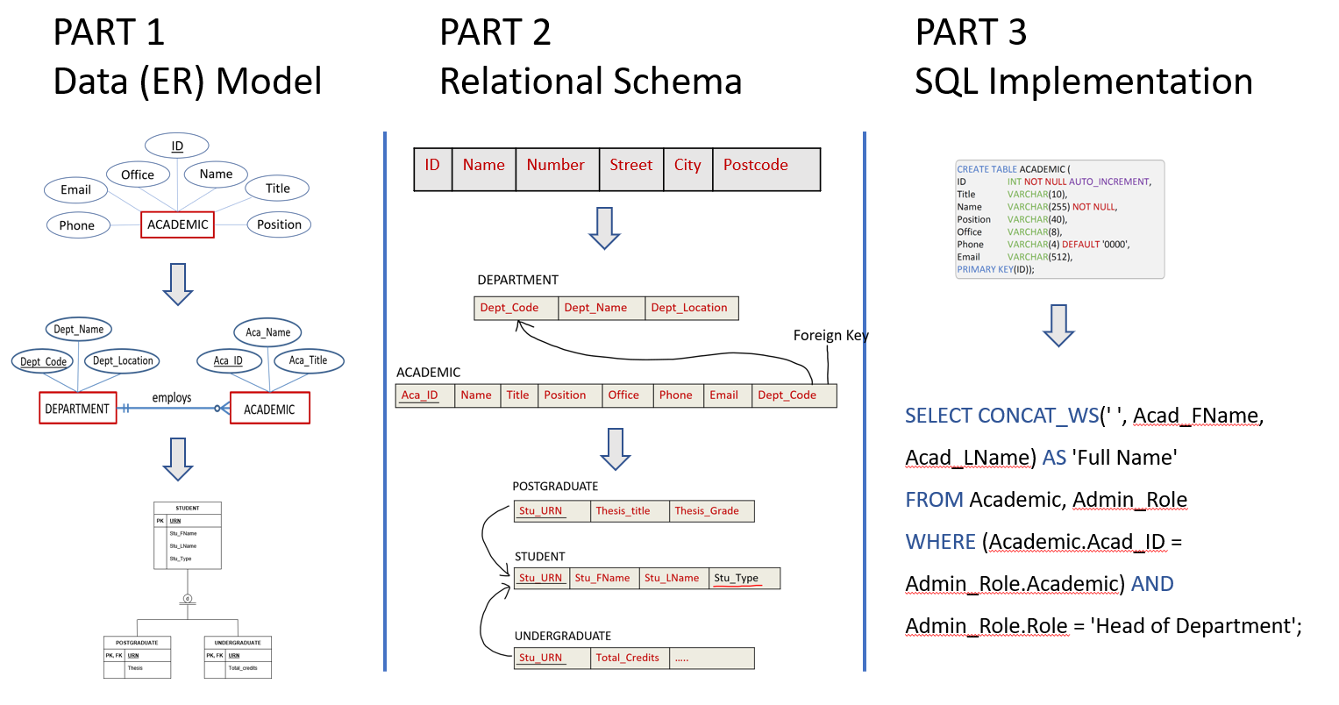


Three parts to modelling
Notes:
I like to work with my students in partnership
This module has developed and grown every year based on students’ feedback
Every individual comes with their prior knowledge and will have a different learning path towards the end goal
I am there to guide you towards that end goal

Slide 55
Entity Relationship Modelling: Entities & Attributes
Notes:
“Learn about the key technologies of Database systems and the World Wide Web (WWW)”. Why is the important?
Databases are the core component of most computer application.

Slide 56
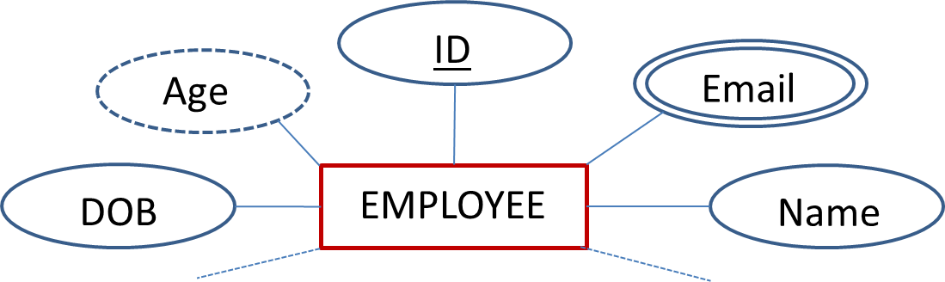
Learning Objectives
At the end of this section, you should be able to:
Describe what an entity is and how to represent it in the ER model
Describe the different types of attributes and how they are represented in the ER model
Notes:
So at the end of this lesson, you should be able to describe what an entity is and how it represented in the E.R. model and also
0:11
how to describe the different types of attributes and how they're presented in the E.R. model.

Slide 57
Entities
Entity: real-world “object” that can exist independently and about which we want to store information
Conceptual Entity
Physical Entity
DEGREE
CAR
ACCOUNT
STUDENT
ORDER
HOUSE
Notes:
So an entity is any real world object that can exist independently and about which we want to store some information and entities can be conceptual,
0:31
which means that they don't have a physical existence. For example, a degree is a conceptual entity.
It exists as a concept, but it is not a physical object that we can touch and feel in this world.
Another example of a conceptual entity is an account, a bank account or an order.
When you do an order that is a conceptual entity because we cannot physically
Examples of physical entities would be a car, a student.
A house, all these are physical entities.
The simplest database contains information about one entity, which is some real-world thing. Some entities are physical— CUSTOMER, ORDER, and STUDENT; others are conceptual— WORK ASSIGNMENT and AUTHORSHIP.
An entity is a “thing” or “object” in the real world with an independent existence that is distinguishable from all other
University Programme
Grade
Module
Lecture
Fees
Degree
Student
Academic
Tutor
Admin Staff
Lecture Hall
Lab

Slide 58
Entities, Entity Sets, Entity Types
Entities
Mariam Cirovic
Joey Lam
Nick Frymann
ENTITY INSTANCES
Entity Set
{Mariam Cirovic, Joey Lam, Nick Frymann}
Entity Type
All academic (entities) belong to the “ACADEMIC” type
ACADEMIC
Notes:
Now let's look at exactly what we mean by entities, entity sets an entity types not.
1:25
For example, if you take my name, Meriem Chair Vage, Joy Lam and Andrew Cresson.
We are entity instances or entity or currencies, actually.
1:40
And when you put us all together,
we are an entity set and an entity type actually is when we can name the set to which all of these entity or currencies can belong.
So, for example, for us, we can call this entity type academic.

Slide 59
Attributes
Attribute: property or characteristic of an entity
ID
Age
Email
DOB
EMPLOYEE
Name
Domain: set of permitted values for each attribute
Age: range between 16 and 70
ID: 4-digit number starting with 1
Notes:
Now, an attribute is a property or characteristic of an entity which helps to define basically what it is to characterise it.
2:21
Now, let's take the example of an employee, not an employee can have a name.
Can have a date of birth, which is often abbreviated as Abby would have an I.D.
An age. And. Perhaps more than one email address.
2:46
If you notice, three of the entities are represented the same way and then Oval, while one has attached a wall and one has got a double line.
S
Now, a domain is a set of permitted values for each attribute type.
3:11
For example, the age we specified above could range between 16 and 17.
So we know it has to be an integer and it has to be between 16 and 17.
3:24
And then ID, let's say we can specify as being a four digit number, starting with one.
o we will now go ahead and see why these notations are different.

Slide 60
Types of Attributes I
Number
Street
Composite
Address
City
Postcode
Simple
City
Single-valued
User_id
jb0045
jack.ball@gmail.com
j.ball@surrey.ac.uk
Multivalued
Email
Notes:
For example, addresses a good example because an address is composed of a number, a street city and postcode, usually a symbol.
3:50
That tribute is an attribute that does not have any support.
4:00
It cannot be decomposed further. So city would be a good example of his simple attribute.
4:04
A single valued attribute is an attribute that can have only one value.
4:10
For example, user ID would be a good example of that.
4:16
A multi valued attribute is an attribute that can have more than one value.
4:21
For example, a student could have more than one email address,
4:26
they could have their personal email address, and they could have the University of Surrey email address.
Characteristics of entities
Required attribute: must have a value and cannot be left empty
Optional attribute: does not require a value and can be left empty
Domain: set of possible values for a given attribute
Identifier: one or more attributes that uniquely identify each entity instance
Composite identifier: primary key composed of more than one attribute
Composite attribute: attribute that can be subdivided to yield additional attributes
Simple attribute: attribute that cannot be subdivided
Single-valued attribute: attribute that has only a single value
Multivalued attributes: attributes that have many values
at is distinguishable from all other objects or things

Slide 61
Types of Attributes II
Derived (vs Stored)
Employee age calculated from the DOB and the current date
e.g. 2020 – 2002 = 18
Age
Required Attribute
Must have a value
FName
LName
Optional Attribute
Email
Does not require a value
Initial
Notes:
Now, derived attributes are attributes which are not stored in the database that can basically be derived using a computation, for example.
4:37
Age is a good example of a derived attribute. It doesn't have to be calculated and stored.
4:50
It can just be calculated from, for example, the employees or the students date of birth and the current date.
4:56
And a required up to boot is an attribute that has to be given a value, so it needs to have a value given it cannot be null.
5:07
And an optional tribute is an attribute which can be nailed, basically doesn't need to have a value.
5:18
For example, middle initial, there's some people who don't have a middle initials so cannot make initial a required attribute because they can have no value.
And also there might be some students that. But, for example, when they're registering as applicants, they might not yet have an email address.
5:37
So it can basically not have about.

Slide 62
Types of Attributes III
Identifier (Key)
ID
Uniquely identifies every occurrence of the entity
Each entity must have a different value for it
The key attribute must be associated with each instance
Composite Identifier (Key)
LName
DOB
Notes:
Now, the identifier, a key attribute which is usually depicted by an oval with a an underlying under the name of the attribute,
5:50
uniquely identifies every occurrence of the entity.
So that means that each entity must have a different value for it.
6:10
So no occurrence of the entity would have the same value.
6:17
And the key attribute has to be associated with each instance.
6:22
So you cannot, like, not have a value for it. Now, the composite identify key is basically an identifier which is composed of more than one attribute.
For example, you can decide to have somebodies last name and their date of birth as a composite identifier instead of having an ID number.

Slide 63
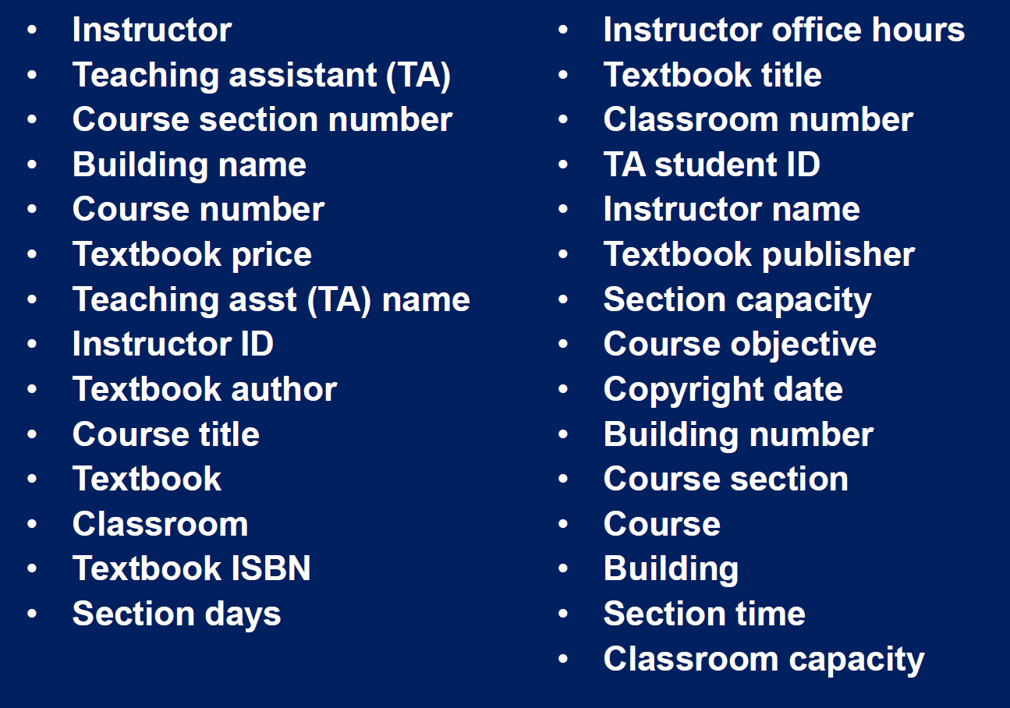
Example 1…
Identify which are entity types and which are attributes
Copyright MIT Opencourseware

Slide 64
Example 2…
A restaurant has an address, seating capacity, phone number, style of food (e.g., French, Russian, Chinese), and number of years in business.
Sketch the ER diagram fragment for the scenario

Slide 65
Database Design Step1: Mapping a Regular Entity Type
Notes:
“Learn about the key technologies of Database systems and the World Wide Web (WWW)”. Why is the important?
Databases are the core component of most computer application.

Slide 66

Learning Objectives
At the end of this section, you should be able to:
Map a regular entity in an ER model to a relation in the relational model using step 1 of the algorithm
Implement the relation using SQL
Notes:
So at the end of this lesson, you should be able to map a recall entity,
0:10
type in an air model to a relation in the relational model using step one of the mapping algorithm,
0:15
and then you should be able to implement this relation using the data definition language of Esquibel.

Slide 67






Modelling a Single-Entity Database
MINIWORLD
UNIVERSITY
REQUIREMENTS COLLECTION AND ANALYSIS
Entity-Relationship Model
CONCEPTUAL DESIGN
Relational Database Schema
LOGICAL DESIGN
SQL Implementation Relational DBMS
PHYSICAL DESIGN
INTERNAL SCHEMA
Notes:
So what we could do here is we're going to take up one entity, let's say from a mini world or universe of discourse, an environment,
0:36
we're familiar with the university, and then we are going to modulate using the entity relationship model, which is at the conceptual level.
0:47
And then we're going to translate that to the relational database schema, which is at the logical level.
0:58
And then we are going to implement it in a relational database management system using Escuela.

Slide 68

An Entity in University
Entity:
An object in the mini-world / /domain / business environment
Programme
Entity name
Needs to be descriptive of the objects in the domain
Should use terminology that is familiar to the specific users of the domain
Nouns in the language translate to entities in the ER Model
Academic
UNIVERSITY
Student
Module
Business Rules
“A student must register on a Programme”
“An academic must teach a module”
Notes:
Now, let's look at entities in the university. Firstly, what is an entity, an entity is an object in the medical domain, business environment,
1:17
whatever you want to call it, for example, in the university, could be a programme, an academic, a student or module.
1:28
If you recall, academic and student would be basically a physical entity types, while programme and module would be conceptual entity types.
1:37
The entity name needs to be descriptive of the objects in the domain, for example, as we saw earlier in the entity relationship model,
1:49
when you hear of Maryam Chairer, which Joy Lam, Andrew Crosson, these are really the entities and academic was the entity type.
1:58
Same with module over here.
2:11
We decide to call whatever you teach in one semester module.
2:15
And again, this is within England and sorry, in other universities, for example, in America they might be called a just a course and not a module.
2:19
Now, the entity they should use, terminology that is familiar to the specific users of the domain, as I said earlier,
2:31
that has to be specific to the environment you are and things can be different in different environments.
2:39
And usually nouns in the language translate to entities in the entity, relationship model and proper nouns are the entities well.
2:45
Otherwise the standard nouns then become the entity types.
2:55
Now business rules could be, for example, students register on a programme and academics teach modules to students.
3:01
So these, we could say basically are the business rules that are linking these four entity types that we have identified in the university domain.
Proper naming
Facilitates communication between parties
Promotes self-documentation
Nouns translate into entities
Business Rule
sets the stage for the proper identification of entities, attributes, relationships, and constraints

Slide 69
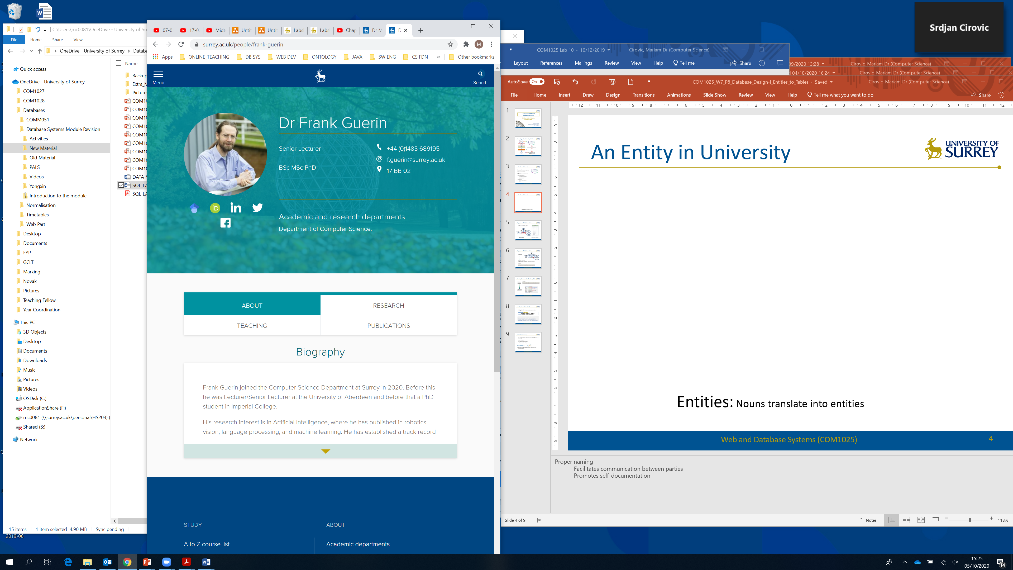
Attributes of an Entity Type
Attribute name
Needs to be descriptive of the data that the attribute is representing
Entity Type: Academic
Attribute 1: Name
Attribute 2: Title
Attribute 3: Position
Attribute 4: Phone
Attribute 5: Email
Attribute 6: Office
……………..
Qualifications, Photo, Social Media Accounts, publications
Notes:
Now, let's look at how we can get the attributes of an entity type.
3:29
Now, this is the Web page of Frank, who's one of the senior lecturers in our department,
3:34
and let's see how we can elicit attributes through looking at this Web page.
3:43
Now, an attribute name needs to be descriptive of the data that the attribute is representing.
3:48
So let's look at this entity, which is entity type, actually, which is academic.
3:55
And let's see the first things we can get.
4:01
We can get the academics name, which is franker, and so we can call one attribute name.
4:07
And also the doctor here is basically a title so they can have another attribute, which is the title.
4:14
And that we see here, we have senior lecturer that basically is the position of Frank, so that could be an attribute name.
4:23
And next we see there is his phone number so we can put phoneys and attribute theme.
4:31
And next is his email and then his office number, basically.
4:36
So all these can be attributes for the entity type academic.
4:41
Now, as you see, there are other attributes there as well, such as qualifications, photo, social media accounts and publications.
4:47
And we'll come back to some of them later, because at the moment we're just looking at the simple attributes.

Slide 70
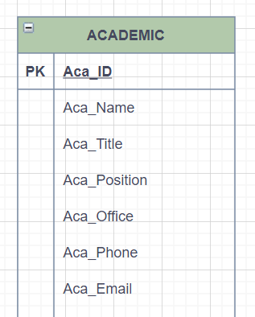
An Entity in an ER Model
An Academic Entity Type
ID
Office
Name
Email
Title
Phone
ACADEMIC
Position
Chen notation
Crows-foot notation
Notes:
Now, this slide shows through a presentation of the academic entity, type in the communication as well as the cross notation.
5:02

Slide 71

Mapping an Entity to a Relation
STEP 1: Mapping of a regular Entity type
(with simple attributes)
ID
ER Model
Office
Name
Email
Title
Phone
ACADEMIC
Position
Relation Schema
ACADEMIC (ID, Name, Title, Position, Office, Phone, Email);
ACADEMIC
ID | Title | Name | Position | Office | Phone | Email
Notes:
Now let's see how we can map this entity to a relational schema.
5:14
Now, step one of the mapping algorithm is of a regular entity type with simple attributes.
Now the model will go to the relational schema,
Each entity becomes a relation.
such that the entity name becomes the name of the relation
each of the simple attributes of the entity relation model become attributes in the relational schema,
and the identifier attribute of the academic entity type will become the primary.
5:56

Slide 72

Mapping an Entity to a Relation
STEP 1: Mapping of a regular Entity type
(with composite attributes)
ER Model
Number
Street
ID
Address
City
Postcode
Name
ACADEMIC
Relation Schema
ACADEMIC (ID, Name, Number, Street, City, Postcode);
ACADEMIC
ID | Name | Number | Street | City | Postcode
Notes:
Now, if you have composite attribute,
6:14
you basically do away with the main a name of the attribute.
For example, you will not use address. Let's see how we do that.
That's our model to schema.
And you will not use the address, but you will take each of the sub attributes and they will become then attributes in the relation schemas.
If you look there. The name is the same academic I did away with some of the attributes just to make it easier to demonstrate it to you.
And the identifier becomes the primary key.
Then you have the name of the academic, which is an attribute in the relation schema and then the composite attribute.
Basically what you do is you put the number Streed City in postcode so you won't put address that you do away with that.
And each one of these sub attributes becomes a direct attribute in the academic relational table.

Slide 73
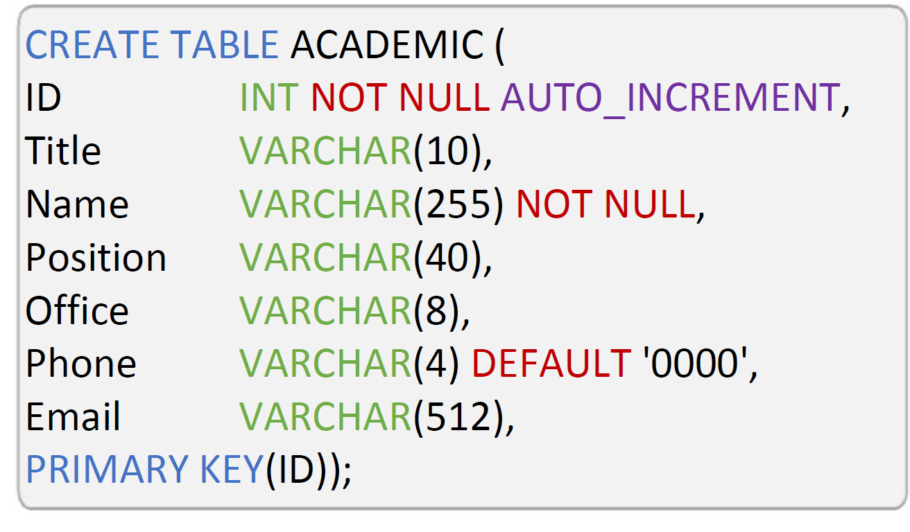

Creating Database Table Using SQL
Relation Schema
ACADEMIC
ID | Title | Name | Position | Office | Phone | Email
SQL (DDL) Statement
Notes:
Now that we have the relations schema,
7:27
let's see how we can use that to write an actual detailed statement to create a table in the MySQL database system.
7:29
So here we see the create table statement and the create a table is the close.
7:44
And then you have the name of the table, which will be academic. And then I.T., which is the primary key, is specified as not null.
7:51
And we did in order to increment. You'll see that later when you do your lab work where the primary key is generated automatically.
8:03
And if you see below, we've specified the constraint that the primary key is the I.D. And if you see all the different attributes,
8:12
have got their data types there and some of them have been specified as not null.
8:22
And some, like the phone, have been given a default of, for example, that's been given a default of zero zero zero zero.
8:28
And now you will see how that will work in reality when you try out the lab.
255 – one computer memory unit

Slide 74
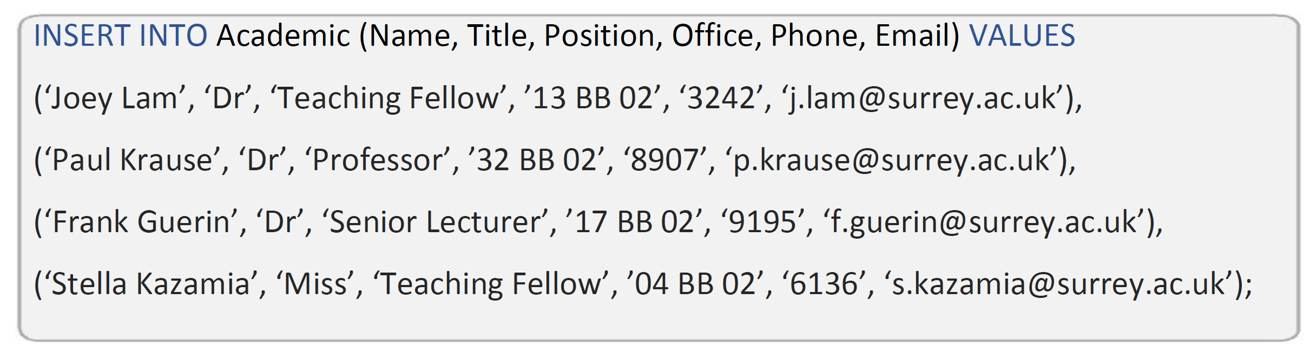
Inserting Data in the Table
Using SQL DDL to insert values into a table
INSERT INTO table_name
(column_1, column_2,…, column_n)
VALUES (value_1, value_2,…,value_n);
Notes:
The next thing to do now that we created the table is to insert some values into the table,
8:44
and if you see up here, we have the insert table statement that we saw earlier.
8:49
So basically we need to specify the name of the table and then we need to specify all the columns of the table that we want to insert the values into.
8:58
And then we need to insert the values in the correct order.
9:08
For example, for the attribute name, there has to be the name, the first position, the names of all the academics.
9:13
The second position has to be for the title and then the position of the academic office, phone, email and so on, basically.

Slide 75
SQL Unary Operators: Querying a Table
Notes:
“Learn about the key technologies of Database systems and the World Wide Web (WWW)”. Why is the important?
Databases are the core component of most computer application.

Slide 76
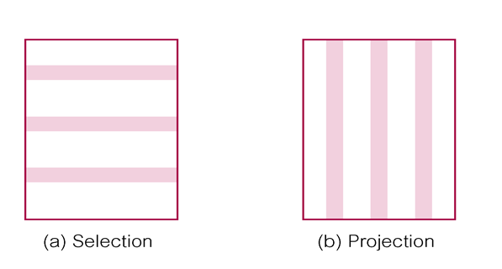
Learning Objectives
At the end of this section, you should be able to:
Describe how the select unary operation of the SQL DDL works
Describe how the project unary operation of the SQL DDL works
Notes:
So at the end of this lesson, you should be able to describe how the select unary operation works off the school DDL
0:11
and also how the project unary operation works of the school data definition language.
0:21

Slide 77


Set Operations on Relations
Unary operations
Notes:
Now, you saw these set operations earlier in the relational model,
0:30
and we're going to now look at how we can use the two unary operations selection and projection.
The physical order of the records or fields in a table is completely immaterial, and each record in the table is identified by a field that contains a unique value.
Select (restrict)
Unary operator that yields a horizontal subset of a table
Project
Unary operator that yields a vertical subset of a table
Union
Combines all rows from two tables, excluding duplicate rows
Union-compatible: tables share the same number of columns, and their corresponding columns share compatible domains
Intersect
Yields only the rows that appear in both tables
Tables must be union-compatible to yield valid results

Slide 78
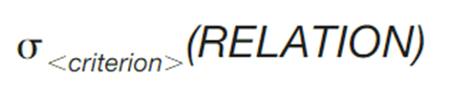
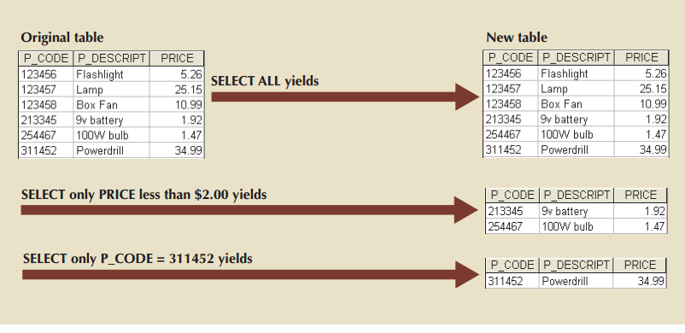
Relational Operator SELECT
Select (restrict)
Unary operator that yields a horizontal subset of the rows of a table
© Cengage: Database Systems –Design, Implementation & Management, Coronel & Morris
Notes:
Now, what's select does is that it gives you basically a horizontal subset of the table.
0:44
This is also known as restricting the data.
0:54
If you look at these examples below, you have the original table and select all will basically give you a new table,
0:57
which is exactly the same as the original table. And a select only prise gives you back two rows and select only peacoat, which is a certain value.
1:04
It gives you back only one row. Now let's look at our employee table and see what an ESKIL query is.

Slide 79
Querying a Database
SQL Query:
a question or request for information translated to a DML to act on the stored data
To display all the Data in a table:
EMPLOYEE
EMP_ID | EMP_NAME | DEPT_NO | SALARY
1234 | Sam Smith | 3 | 30000
1235 | Joe Ball | 4 | 50000
1230 | Mark Malon | 3 | 800000
1239 | Chris Clark | 4 | 100000
EMPLOYEE
SELECT * FROM table_name;
EMP_ID | EMP_NAME | DEPT_NO | SALARY
1234 | Sam Smith | 3 | 30000
1235 | Joe Ball | 4 | 50000
1230 | Mark Malon | 3 | 800000
1239 | Chris Clark | 4 | 100000
SELECT * FROM EMPLOYEE;
Notes:
Basically, that's your query is a question or request for information translated to data manipulation language to act on the stored data,
1:25
and for example, to display all the data in the table.
1:36
You use a little star symbols. You say select the star symbol from table name.
1:40
And for example, we can say select a star symbol from employee and basically get back the whole table.
1:47

Slide 80
Querying a Table: SELECT
Selection
Returns all rows found in a table
Horizontal slice
EMPLOYEE
EMP_ID | EMP_NAME | DEPT_NO | SALARY
1234 | Sam Smith | 3 | 30000
1235 | Joe Ball | 4 | 50000
1230 | Mark Malon | 3 | 800000
1239 | Chris Clark | 4 | 100000
WHERE clause can contain several conditions linked by AND/OR
SELECT * FROM table_name WHERE <condition>;
EMPLOYEE
SELECT * FROM EMPLOYEE WHERE DEPT_NO = 4;
EMP_ID | EMP_NAME | DEPT_NO | SALARY
1235 | Joe Ball | 4 | 50000
1239 | Chris Clark | 4 | 100000
Notes:
Now, let's see how we can query the employee table using the select statement now selection returns all the rows which are found in a table.
1:57
It is a horizontal slice, as we saw earlier. And the syntax is, for example, select from table name where there's a certain condition.
2:08
And star means that we select all the rows and this condition can basically is you used through where clause,
2:20
which can contain several conditions linked together by end and or operators.
2:28
Now, select staff from employee, let's say with department number is equal to four,
2:35
will pick out these two rows and it will yield a new relation, which is basically composed of just those two rows of data.
Projection means choosing which columns (or expressions) the query shall return.
Selection means which rows are to be returned.
if the query is
select a, b, c from foobar where x=3;then "a, b, c" is the projection part, "where x=3" the selection part.
the SELECT clause actually performs a projection (not selection), and it's the WHERE clause that actually performs a selection
Simply PROJECTION deals with elimination or selection of columns, while SELECTION deals with elimination or selection of rows.
Projection: what ever typed in select clause i.e, 'column list' or '*' or 'expressions' that becomes under projection.
*selection:*what type of conditions we are applying on that columns i.e, getting the records that comes under selection.
For example:
SELECT empno,ename,dno,job from Emp WHERE job='CLERK'; in the above query the columns "empno,ename,dno,job" those comes under projection, "where job='clerk'" comes under selection
Projections and Selections are two unary operations in Relational Algebra and has practical applications in RDBMS (relational database management systems).
In practical sense, yes Projection means selecting specific columns (attributes) from a table and Selection means filtering rows (tuples). Also, for a conventional table, Projection and Selection can be termed as vertical and horizontal slicing or filtering.

Slide 81
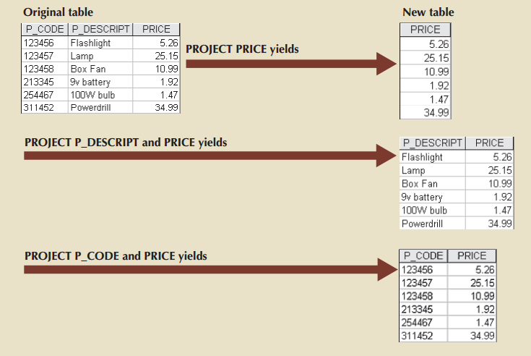
Relational Operator PROJECT
Project
Unary operator that yields a vertical subset of the columns of a table
© Cengage: Database Systems –Design, Implementation & Management, Coronel & Morris
Notes:
Now, the relational operator project is unary operator that yields a vertical subset of the table.
2:54
If you look at the example here, if you say Project Price on the original table, you basically get the whole column, but all the values for the price.
3:02
And you can also pick basically any other combination of columns.
3:14
You can have two columns or one column depending on what you look

Slide 82








Querying a Table: PROJECT
Projection
Returns all columns found in a table
Vertical Slice
EMPLOYEE
EMP_ID | EMP_NAME | DEPT_NO | SALARY
1234 | Sam Smith | 3 | 30000
1235 | Joe Ball | 4 | 50000
1230 | Mark Malon | 3 | 800000
1239 | Chris Clark | 4 | 100000
SELECT column_1, ….., column_n
FROM table_name;
EMPLOYEE
EMP_NAME | SALARY
Sam Smith | 30000
Joe Ball | 50000
Mark Malon | 800000
Chris Clark | 100000
SELECT EMP_NAME, SALARY
FROM EMPLOYEE;
Notes:
let's look at it further through our employee table.
3:20
Again, sort of projection returns, all the columns found in a table.
3:32
It is a vertical slice and the Syntex is a select any number of column names from the table name.
3:36
For example, you could say salad, select employee name and salary from employee,
3:47
and basically you will get back on this new table, which just contains those two columns.
3:52
Projection means choosing which columns (or expressions) the query shall return.
Selection means which rows are to be returned.
if the query is
select a, b, c from foobar where x=3;then "a, b, c" is the projection part, "where x=3" the selection part.
the SELECT clause actually performs a projection (not selection), and it's the WHERE clause that actually performs a selection
Simply PROJECTION deals with elimination or selection of columns, while SELECTION deals with elimination or selection of rows.
Projection: what ever typed in select clause i.e, 'column list' or '*' or 'expressions' that becomes under projection.
*selection:*what type of conditions we are applying on that columns i.e, getting the records that comes under selection.
For example:
SELECT empno,ename,dno,job from Emp WHERE job='CLERK'; in the above query the columns "empno,ename,dno,job" those comes under projection, "where job='clerk'" comes under selection
Projections and Selections are two unary operations in Relational Algebra and has practical applications in RDBMS (relational database management systems).
In practical sense, yes Projection means selecting specific columns (attributes) from a table and Selection means filtering rows (tuples). Also, for a conventional table, Projection and Selection can be termed as vertical and horizontal slicing or filtering.

Slide 83
SELECT & PROJECT
The select and project operations are usually combined in the SELECT statement
EMPLOYEE
EMP_ID | EMP_NAME | DEPT_NO | SALARY
1234 | Sam Smith | 3 | 30000
1235 | Joe Ball | 4 | 50000
1230 | Mark Malon | 3 | 800000
1239 | Chris Clark | 4 | 100000
SELECT column_1, …, column_n
FROM table_1,….table_n
WHERE <condition_1,…condition_n>;
EMPLOYEE
SELECT EMP_NAME, SALARY
FROM EMPLOYEE;
WHERE DEPT_NO = 4;
EMP_NAME | SALARY
Joe Ball | 50000
Chris Clark | 100000
Notes:
Now, the select and project operations are mutually combined together in the select statement, and it has the following syntax.
4:02
So you have the select clause with the list of column names you want to select,
4:12
and then you have the front clause with the number of with a list of tables that you want to select them from.
4:16
And then you have the where clause with all the different conditions that you want to use to filter out the results.
4:24
For example, if you run this statement, select employee names,
4:31
salary from employee with department number is equal to for what you do first is you pick out the
4:35
department number and then the employee name and salary of all the employees that work in that department.
4:44
And you get this result in table, which basically has retrieved two rows.
And I'm just reiterating again that if you remember, every time you use these operations on relations, you come back with a single new relation.
Projection means choosing which columns (or expressions) the query shall return.
Selection means which rows are to be returned.
if the query is
select a, b, c from foobar where x=3;then "a, b, c" is the projection part, "where x=3" the selection part.
the SELECT clause actually performs a projection (not selection), and it's the WHERE clause that actually performs a selection
Simply PROJECTION deals with elimination or selection of columns, while SELECTION deals with elimination or selection of rows.
Projection: what ever typed in select clause i.e, 'column list' or '*' or 'expressions' that becomes under projection.
*selection:*what type of conditions we are applying on that columns i.e, getting the records that comes under selection.
For example:
SELECT empno,ename,dno,job from Emp WHERE job='CLERK'; in the above query the columns "empno,ename,dno,job" those comes under projection, "where job='clerk'" comes under selection
Projections and Selections are two unary operations in Relational Algebra and has practical applications in RDBMS (relational database management systems).
In practical sense, yes Projection means selecting specific columns (attributes) from a table and Selection means filtering rows (tuples). Also, for a conventional table, Projection and Selection can be termed as vertical and horizontal slicing or filtering.

Slide 84
SQL Operators
EMPLOYEE
Arithmetic operators
+ - * / %
Comparison operators
= > < >= <= <>
Logical operators
AND OR LIKE BETWEEN IN SOME NOT
EMP_ID | EMP_NAME | DEPT_NO | SALARY
1234 | Sam Smith | 3 | 30000
1235 | Joe Ball | 4 | 50000
1230 | Mark Malon | 3 | 800000
1239 | Chris Clark | 4 | 100000
EMPLOYEE
SELECT EMP_NAME, SALARY
FROM EMPLOYEE;
WHERE DEPT_NO = 4 AND SALARY > 60000;
------------
EMP_NAME | SALARY
Chris Clark | 100000
EMP_NAME | SALARY
Joe Ball | 50000
Chris Clark | 80000
WHERE SALARY BETWEEN 40000 AND 90000;
Notes:
Now let's have another look at rescue operators.
5:13
You can have arithmetic operators, you can have comparison operators equal to greater than less than you can have the logical operators,
5:17
for example, and or like between and illustrate another example.
5:27
Now, let's say we select the employee name and salary from employee where the department number is for and salary is greater than 60000.
5:32
So you're going to pick one roadbed because that's the only road that satisfies this condition.
5:44
And we get our result and table. Let's do another one where we want to, let's say, select employee name and salary from employee,
5:50
where the salary is between four thousand sorry, 40000 and 90000.
5:59
And now we get a result and table with two rows. We get the two employees whose salary falls between those two, which is the condition we specify.

Slide 85
KEY POINTS TO TAKE AWAY
A relational model is based on a mathematical foundation and consists of a set of relations (tables) to store data, a set of integrity rules to ensure data consistency and a set of operations to manipulate data
Entity Relationship Modelling is a conceptual model represented graphically and the starting point for relational database design
SQL is a comprehensive language for database management and supports data definition and data manipulation
Database design starts with eliciting business rules, which are used as the basis of the ER modelling and translation to relational schema and SQL implementation
Entities are “real world” concepts that have attributes (characteristics). An entity translates to a relation, which can be implemented as a table in MySQL using SQL DDL: Step 1 of the mapping algorithm
A table can then be queried using SQL DML unary operators
Notes:
A relational database is a collection of relations linked by keys
Mathematical foundation of relational algebra
Provides for data integrity and manipulation
Relational model is at the logical level – next we move to the conceptual level…..
The ER model is the most popular for conceptual modelling
Easier to examine structures visually/graphically
ER Modelling is the starting point for database design
SQL is a comprehensive language for database management
Supports data definition and manipulation, querying and constraint specification
There are four main stages of the database design process
Eliciting the correct business rules is an important first step
Conceptual (ER) model is mapped to the logical (Relational) model, which is implemented using SQL
Entities are real-world “things” that can exist independently
Entities may be conceptual or physical
Entities have attributes that classify them
Data modelling is a three phase process:
STEP 1: Mapping Algorithm ER Entity to Relational Schema
SQL Database Manipulation Language (DML) allows you to query data
Unary Operators:
Select (horizontal slice)
Project (vertical slice)
Practice SQL DDL & DML in the lab using the MySQL database server

Slide 86

Next Steps
Make sure you do the quiz to test that you have understood the main concepts
In the lab you will put into practice the Step 1 of the mapping algorithm
Use ER modelling to model an entity
Translate to relational schema
Implement using SQL in MySQL using the Data Definition Language
Query the table using SQLs Data Manipulation Language
Give your feedback on muddiest point/clearest point
Notes:
A relational database is a collection of relations linked by keys
Mathematical foundation of relational algebra
Provides for data integrity and manipulation
Relational model is at the logical level – next we move to the conceptual level…..
The ER model is the most popular for conceptual modelling
Easier to examine structures visually/graphically
ER Modelling is the starting point for database design
SQL is a comprehensive language for database management
Supports data definition and manipulation, querying and constraint specification
There are four main stages of the database design process
Eliciting the correct business rules is an important first step
Conceptual (ER) model is mapped to the logical (Relational) model, which is implemented using SQL
Entities are real-world “things” that can exist independently
Entities may be conceptual or physical
Entities have attributes that classify them

